Slide 1
New Trends in Differential Geometry, L'Aquila, September 7th-9th 2011 Intrinsic torsion varieties of Riemannian almost-product structures
Георги М. Михайлов - Politecnico di Torino

Slide 2
New Trends in Differential Geometry, L'Aquila, September 7th-9th 2011 Intrinsic torsion varieties of Riemannian almost-product structures
Gueorgui M. Mihaylov - Politecnico di Torino

Slide 3
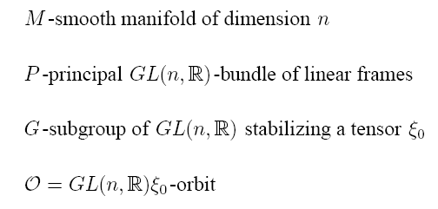
G-structures

Slide 4
Forms on P

Slide 5
Forms on P

Slide 6
Forms on P

Slide 7
Forms on P

Slide 8
The intrinsic torsion

Slide 9
The intrinsic torsion

Slide 10
Null-torsion classification

Slide 11
Null-torsion classification

Slide 12
Null-torsion classification

Slide 13
The Riemannian case

Slide 14
The Riemannian case

Slide 15
Parameter spaces

Slide 16
Parameter spaces

Slide 17
Definition of ITV’s.

Slide 18
Definition of ITV’s.

Slide 19
Definition of ITV’s.

Slide 20
2-forms in a Riemannian context

Slide 21
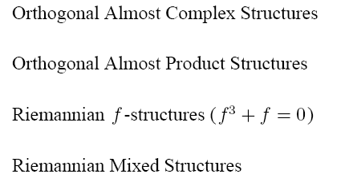
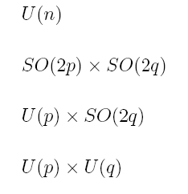
2-forms in a Riemannian context

Slide 22
Coadjoint orbits of SO(6)

Slide 23
Coadjoint orbits of SO(6)

Slide 24
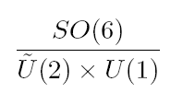
Coadjoint orbits of SO(6)

Slide 25
Coadjoint orbits of SO(6)

Slide 26
Standard symplectic structure

Slide 27
Standard symplectic structure

Slide 28
Structures via 2-forms

Slide 29
Structures via 2-forms

Slide 30
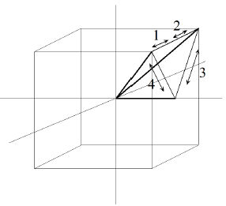
2-forms and polytopes

Slide 31
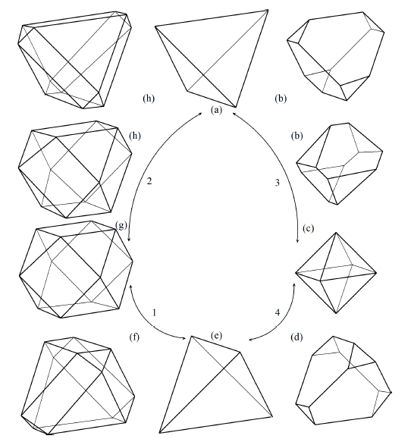
2-forms and polytopes

Slide 32
Differential fibrations
(—) Toric moment mappings and Riemannian structures. (to appear...)
preprint available: arXiv:0810.2799v1 15Oct, 2008

Slide 33
A toric moment map

Slide 34
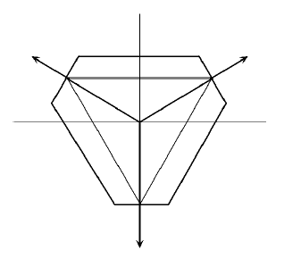
A toric moment map

Slide 35
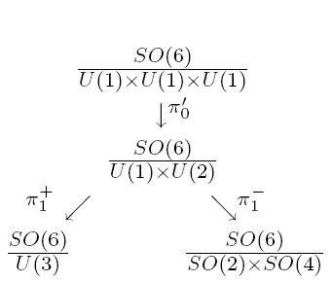
Symplectic fibrations

Slide 36
Symplectic fibrations

Slide 37
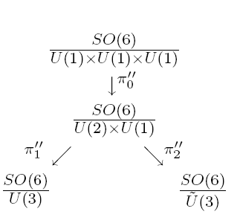
Symplectic fibrations

Slide 38
Symplectic fibrations

Slide 39
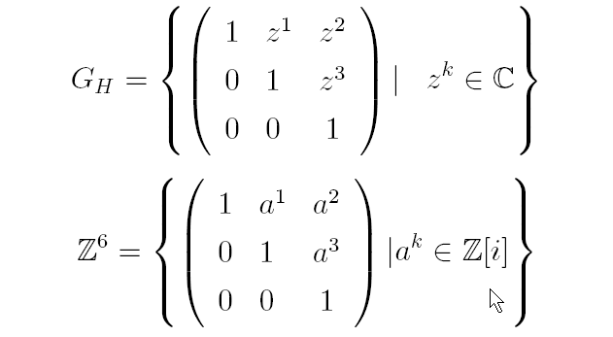
The Iwasawa manifold

Slide 40
The Iwasawa manifold

Slide 41
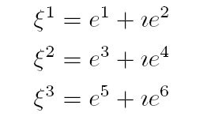
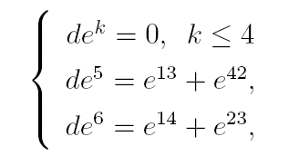
The Iwasawa manifold

Slide 42
Almost Hermitian structures on N

Slide 43
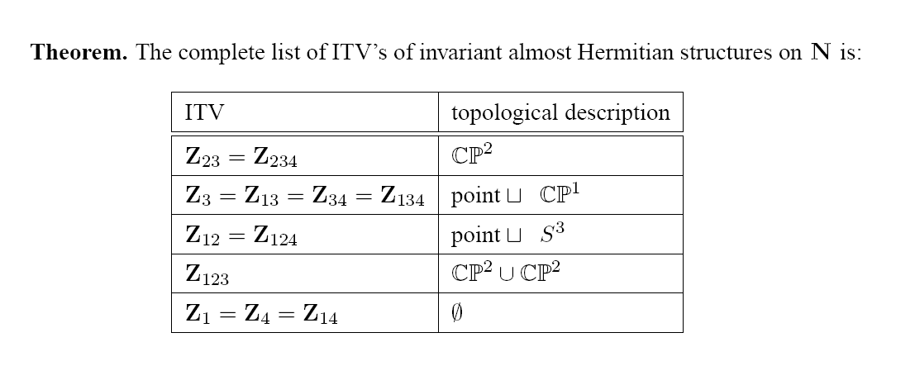
Almost Hermitian structures on N

Slide 44
Almost Hermitian structures on N

Slide 45
Almost product structures

Slide 46
Almost product structures

Slide 47
Almost product structures

Slide 48
An operative criterion

Slide 49
An operative criterion

Slide 50
An operative criterion

Slide 51
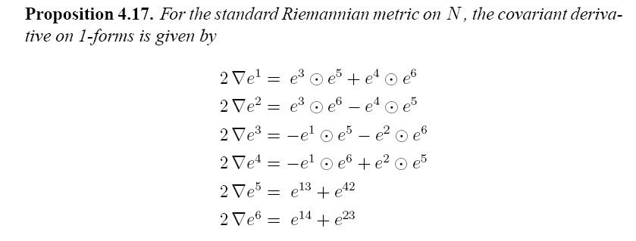
Types of OPS’s on N

Slide 52
Types of OPS’s on N

Slide 53
Types of OPS’s on N

Slide 54
Types of OPS’s on N

Slide 55
Types of OPS’s on N

Slide 56
An example

Slide 57
An example

Slide 58
An example

Slide 59
Another example

Slide 60
Another example

Slide 61
Another example

Slide 62
Another example

Slide 63
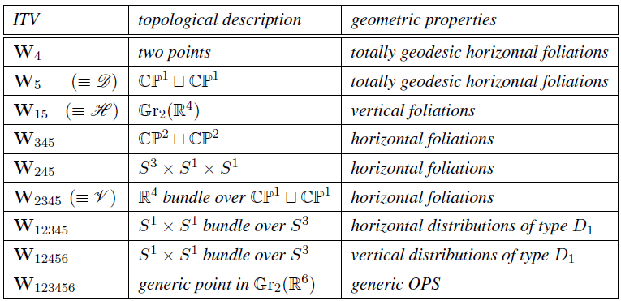
ITV’s of SO(2)xSO(4)-structures on N

Slide 64
Toric invariance

Slide 65
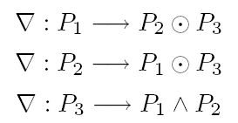
Toric invariance

Slide 66
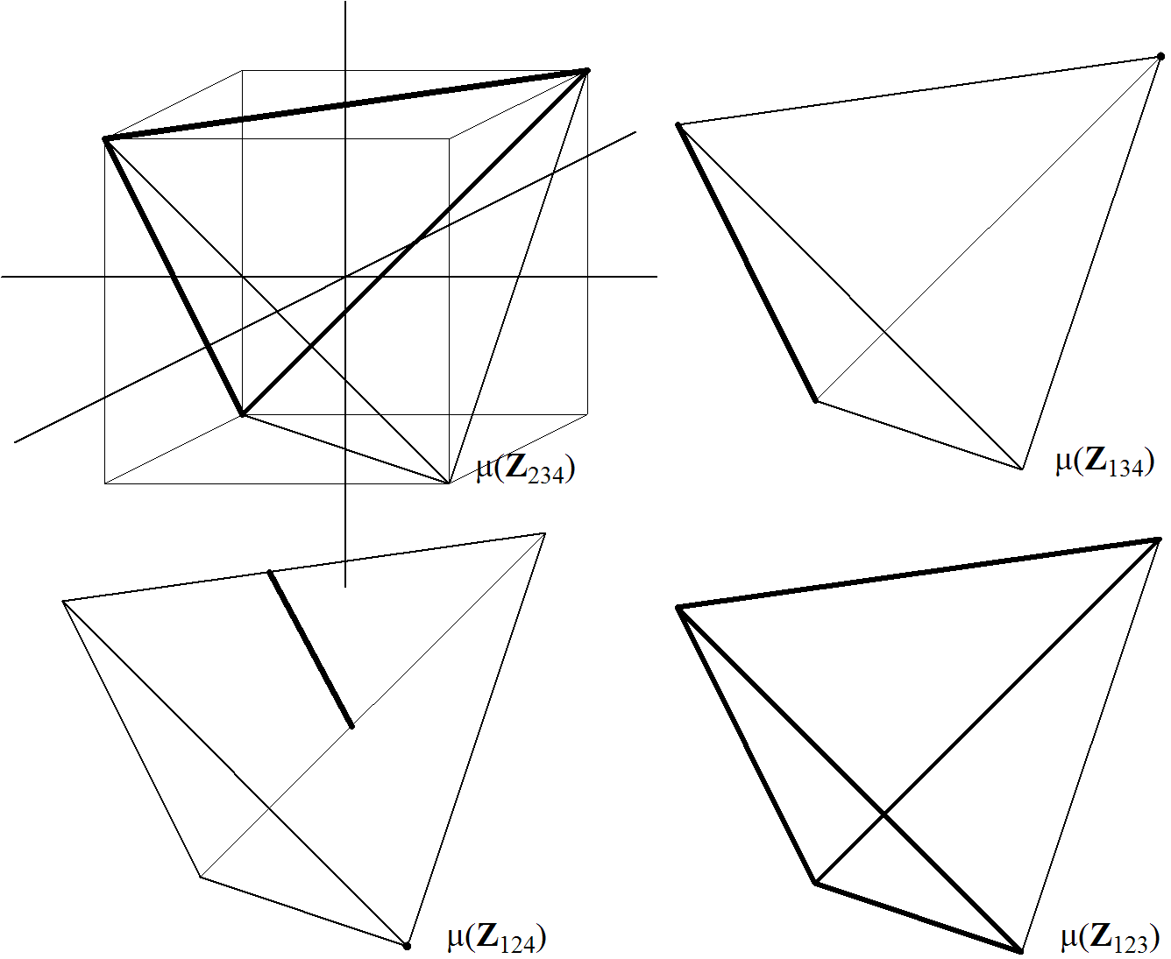
The “geography” of CP³

Slide 67
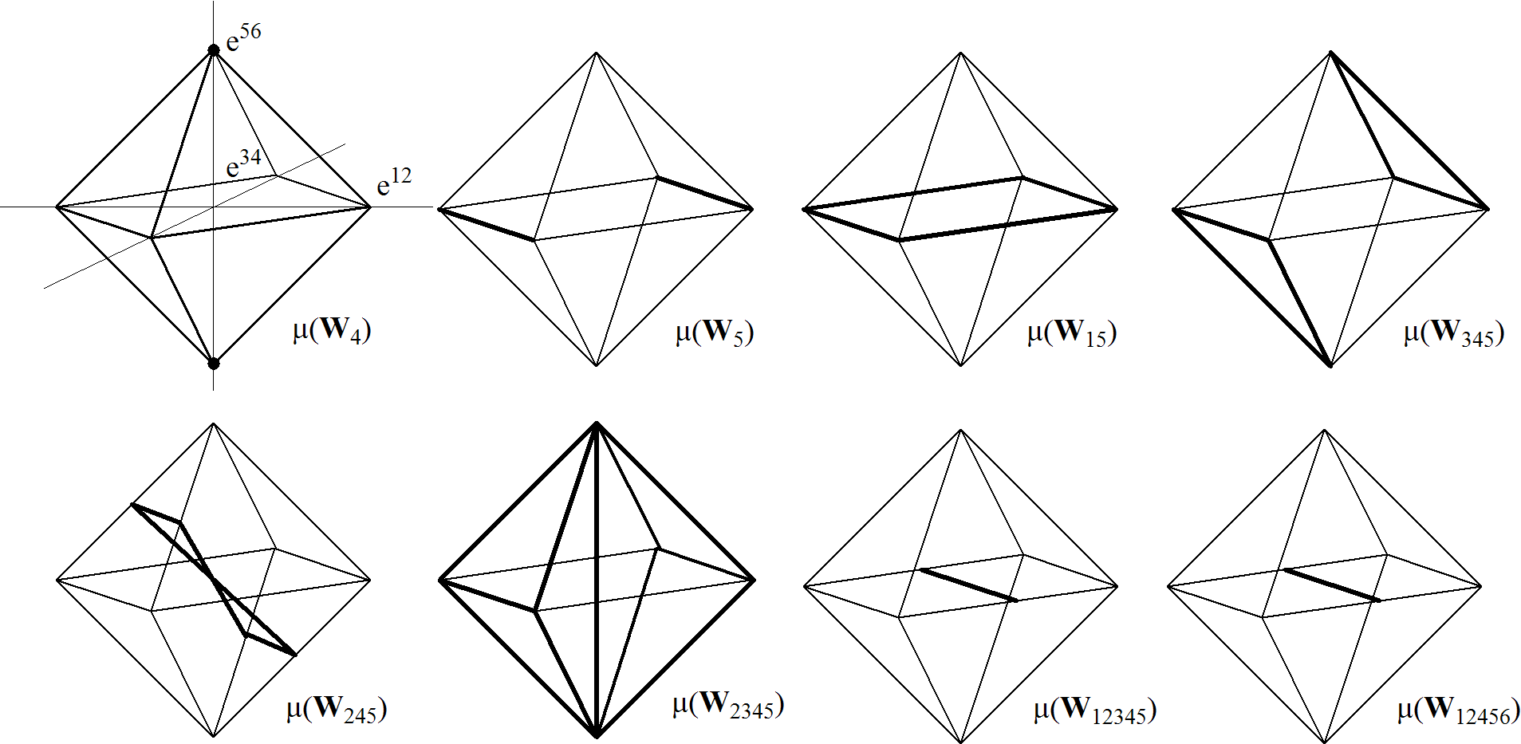
The “geography” of Gr

Slide 68
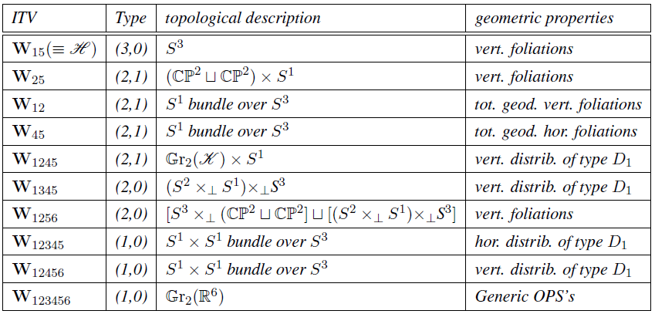
ITV’s of SO(3)xSO(3)-structures on N

Slide 69
The reason

Slide 70
The reason

Slide 71
First-order approach

Slide 72
First-order approach

Slide 73
First-order approach

Slide 74
First-order approach

Slide 75
First-order approach

Slide 76
Second-order approach

Slide 77
Second-order approach

Slide 78
Second-order approach

Slide 79
Second-order approach

