Slide 1


Complex Dynamics and Statistics
in Hamiltonian 1-D Lattices
Anastasios (Tassos) Bountis
Department of Mathematics, School of Science and Humanities, Nazarbayev University
Nur-Sultan, Republic of Kazakhstan
6th European Ph. D. School, International Center for Nonlinear Dynamics and Complex Systems, Prof. Angela de Sanctis,
Universitá “G. d’ Annunzio’’, Pescara, July 3 – 11, 2019

Slide 2



First European Ph.D. School on “Mathematical Modeling of Complex Systems”, 18-29 July 2011
Second European Ph.D. School on “Mathematical Modeling of Complex Systems”, Pescara, 16-28 July 2012
Third European Ph.D. School on “Mathematical Modeling of Complex Systems”, Heraclion, Crete, 15 - 27 July 2013

Slide 3

Fourth European Ph.D. School on “Mathematical Modeling of Complex Systems”, Athens, 14 - 25 July 2014
Fifth European Ph.D. School on “Mathematical Modeling of Complex Systems”, Patras, 20 - 30 July 2015

Slide 4
For the results presented in these lectures, I gratefully acknowledge the collaboration of my former Ph.D. students:
Haris Skokos, currently Associate Professor of Mathematics at Cape Town University, South Africa
2) Christos Antonopoulos, currently Lecturer of Mathematics at
University of Essex, UK
3) Thanos Manos, currently Assistant Professor of Mathematics,
University Cergy Pontoise, Paris, France
4) Helen Christodoulidi, currently researcher at University of Kent
and Research Institute, Academy of Athens
5) Jeroen Bergamin, currently Rector at at a Prototype Gymnasium in
Amsterdam, Netherlands
6) Lambros Drossos, Professor, Techological Educational Institute,
Messolonghi, Greece

Slide 5
Outline of the Lectures
Introduction
Simple Periodic Orbits, Weak and Strong Chaos
Dynamical Indicators of Order and Chaos
Localization in 1-Dimensional Lattices
Complex Statistics of Chaotic Dynamics
The Role of Long Range Interactions
7. LRI and Localization in 1-D Lattices with on-site potential
8. Supratransmission of Energy occurs at Higher
Thresholds in 1 – D lattices under LRI
Part of these lectures are based on my book (co-authored with
Haris Skokos) “Complex Hamiltonian Dynamics” (Springer
Synergetic Series, April 2012).

Slide 6

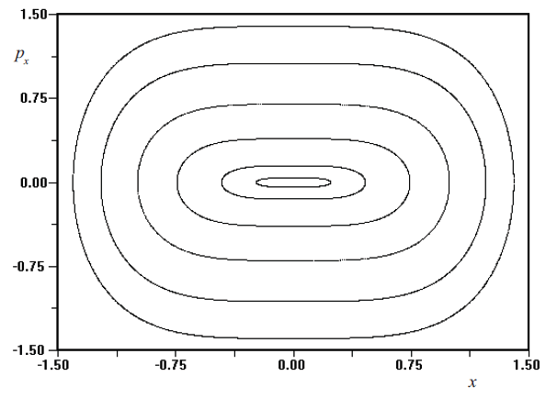
1. INTRODUCTION
H=E, energy constant
The solution of the equations for ε= 0 (the uncoupled case) leads to the figure on the right, which is a surface of section plot on the plane x(t_{k}), p_{x}(t_{k}), (every time y(t_{k})=0).
Thus, in the uncoupled (integrable) case, all curves correspond to periodic and quasiperiodic orbits with two frequencies ω₁ and ω₂.

Slide 7
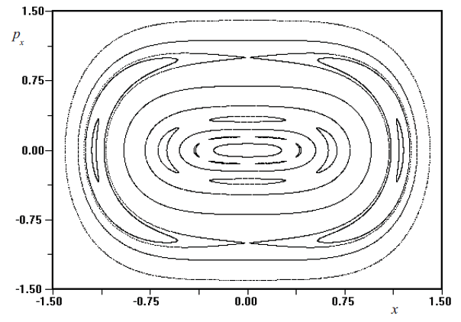
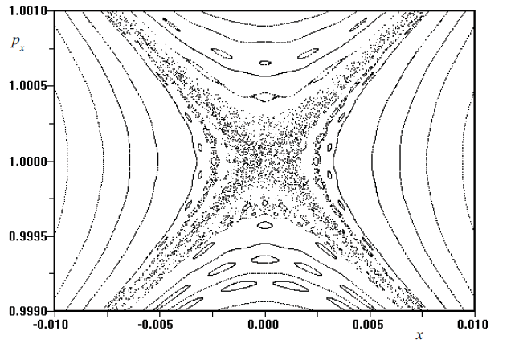
How does chaos arise, when the coupling is turned on?
All we need to do is increase slowly the value of ε > 0 to discover an amazingly complex network of chaotic domains!
Simple Periodic Orbits
Magnification where weak chaos occurs!
Surface of section of the orbits in the plane x(t_{k}), p_{x}(t_{k}), for ε=0.02

Slide 8
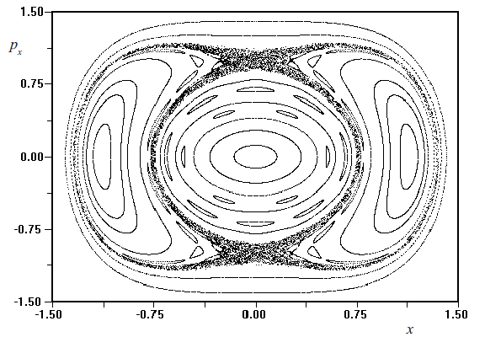
What happens if we further increase ε, say, ε=0.2?
There are regular regions and also “strongly” and “weakly” chaotic domains and they grow with E !

Slide 9
2. SIMPLE PERIODIC ORBITS, WEAK AND STRONG CHAOS
We study Hamiltonian dynamical systems of N degrees of freedom (dof), in an 2N – dimensional phase space of position and momentum coordinates, whose equations of motion are written in the form
(1)
H being the Hamiltonian function. If H does not explicitly depend on the time t, it represents a first integral, whose value gives the total energy of the system E. I will assume that the Hamiltonian can be expanded in power series as a sum of homogeneous polynomials of degree m ≥2
(2) so that the origin is a stable equilibrium point of the system.

Slide 10
We assume that the linear equations resulting from (1) and (2), with H_{m} = 0 for all m > 2, yield a matrix, whose eigenvalues all occur in conjugate imaginary pairs, ±iω_{q} , and thus provide the frequencies of the so-called normal mode oscillations of the linearized system.
where P_{q} , Q_{q} are the normal mode coordinates. Then, according to a famous theorem by Lyapunov, if none of the ratios of these eigenvalues, ω_{j}/ω_{k} is rational, for any j, k = 1,2,…,N, j ≠ k, all linear normal modes continue to exist as periodic solutions of the nonlinear system.
If these frequencies are close to those of the linear modes they are examples of what we call simple periodic orbits (SPOs), where all variables oscillate with the same frequency.

Slide 11
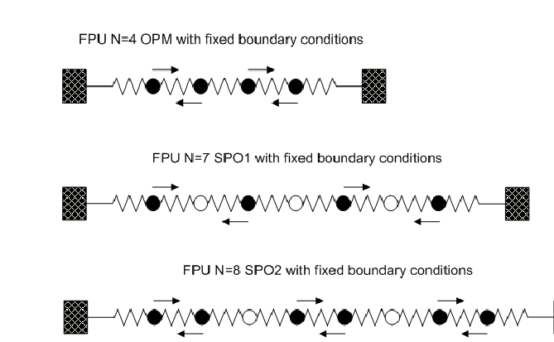
Figure 1 : Examples of SPOs that we have called the Out of Phase
(or pi-) Mode (above), the SPO1 orbit (middle) and the SPO2 orbit
(below).

Slide 12
What is the importance of these SPOs also called nonlinear normal modes, or NNMs? Once we have established that they exist, what can we say about their stability under small perturbations of their initial conditions?
How do these properties change as we vary the total energy? Do such changes affect only the motion in the immediate vicinity of the NNMs or can they also influence the dynamics of the system more globally?
Introducing the spectrum of Lyapunov exponents, I will point out how its convergence properties are connected to the emergence of strongly chaotic behavior in the solutions.
I shall also describe the method of the Generalized Alignment Indices GALI_{k}, k=1,2,…,2N, which efficiently identify domains of chaos and order in N dof Hamiltonian systems and 2N-dimensional (2ND) symplectic maps.

Slide 13
3. INDICATORS OF REGULAR AND CHAOTIC DYNAMICS
An interesting question in Hamiltonian dynamics concerns the connection between the local (linear) stability properties of simple periodic solutions of Hamiltonian systems, with the more “global” dynamics. Let us examine this question using the one-dimensional lattice (or chain) of coupled oscillators called the Fermi Pasta Ulam β-model described by the N dof Hamiltonian
(3)
where x_{j} are the displacements of the particles from their equilibrium positions, and p_{j} = dx_{j} /dt are the momenta, β is a positive real constant and E is the total energy.

Slide 14
,
Let us focus on a some examples of simple periodic solutions
(SPOs), which have well-defined symmetries and are known in closed form, for example:
(I) the out of phase (pi-mode)
with N even, under periodic boundary conditions (pbc),
(II) the SPO1 mode, where every 2 particles one is stationary and those on each side move out of phase,
(III) the SPO2 mode, where every 3 particles one is stationary and the two on each side move out of phase
both under fixed boundary conditions (fbc)

Slide 15
Can they be solved by the same x(t)?
Figure 1 : Examples of SPOs that we have called the Out of Phase
(or pi-) Mode (above), the SPO1 orbit (middle) and the SPO2 orbit
(below).

Slide 16
Applying Lyapunov's Theorem we can prove the existence of SPOs as continuations of the linear normal modes of the system, whose energies and frequencies are
(4)
Thus, our SPO1 and SPO2 orbits, as NNMs, are identified by the indices q = (N+1)/2 and q = 2(N+1)/3 respectively.
An analytical criterion for “weak” chaos:
The above NNMs first destabilize at energy densities
E_{c}/N ~ 1/N ^{α}, α=1,2, as N→∞.
In agreement with an analytical criterion by Flach and co-workers, E_{c}/N ~ π²/6βN², we find that for α = 2 orbits (like SPO2) instability implies “weak” chaos and the breakup of FPU recurrences. On the other hand, if α = 1, where the SPO1 mode destabilizes. we find “stronger” chaos.

Slide 17
3.1 Lyapunov exponents and “strong” chaos
Chaotic behavior is usually studied by evaluating of the spectrum of Lyapunov exponents, L_{i}, i=1,….2N, (LEs) L₁=L_{max}>L₂>….>L_{2N} , defined as follows:
i=1,2,….,N (5)
If L_{max} > 0, the orbit is chaotic, while if L_{max} = 0 the orbit is stable. In the thermodynamic limit, where E→∞ and N →∞ (with E/N fixed), the Lyapunov spectrum near unstable NNMs tends to a smooth curve, see Figure 2(a).
For our two orbits SPO1 and SPO2, at low energies when they are unstable, we find that their Lyapunov spectra are distinct see Figure 2(b,c). Raising the energy, the Lyapunov spectra converge to the same exponentially decreasing function L_{i} (N) ~ exp(-αi/N), ,i=1,2,…,N, thus providing evidence that the orbits explore the same chaotic region.

Slide 18
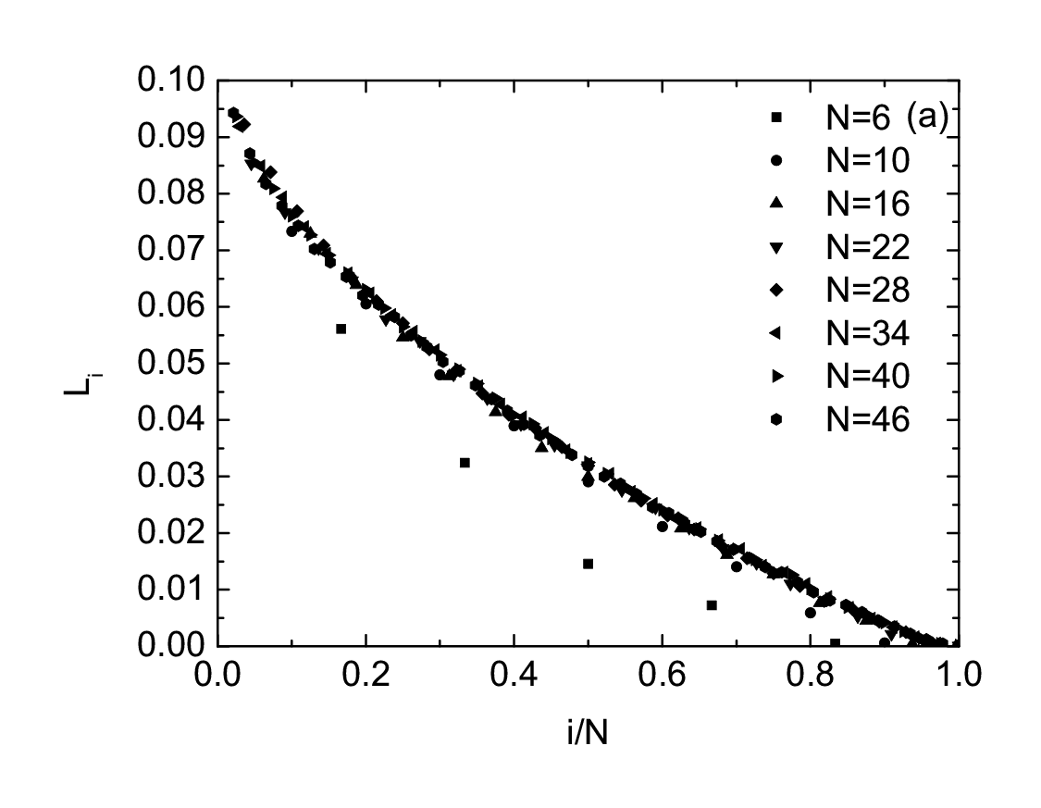
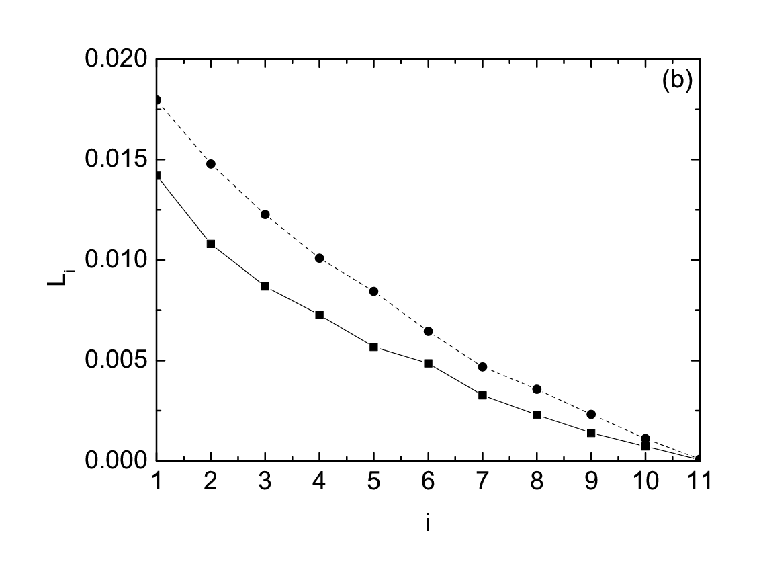
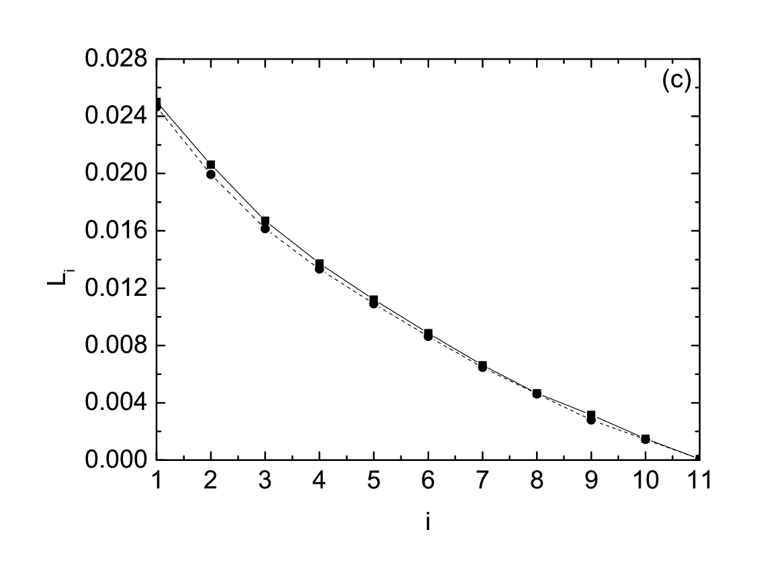
Figure 2. (a) The spectrum of
Lyapunov exponents near an out of
phase orbit of the β – FPU model
as E and N grow (E/N=3/4). In (b) and (c)
the Lyapunov spectra of solutions
starting near unstable SPO1and SPO2
orbits converge, as the energy grows
from E= 2.1 in (b) to E=2.6 for (c),
indicating that the chaotic regions about
these orbits have merged!

Slide 19
3.2 Beyond Lyapunov exponents: The Generalized Alignment Indices (GALI)
The GALI indicators: (a) detect the chaotic nature of the orbits more rapidly than other methods and, (b) identify quasiperiodic motion providing also the dimension of the torus.
The GALI_{k}, k = 2,…., N are defined, through the evolution of k initially linearly independent deviation vectors w_{i} (0), as the volume of a k-parallelepiped given by the wedge product
whose k edges are the unitary deviations .
Thus, it is evident that if at least two of the deviation vectors become linearly dependent, the wedge product in (6) becomes zero and the GALI_{k} vanishes.
, i = 1,2,…,k (6)

Slide 20
Behavior of GALI₂ for chaotic motion
For chaotic orbits the two deviation vectors tend to become linearly dependent in the direction defined by the maximal Lyapunov exponent.
GALI₂ (t)
P(t)
GALI₂ (0)
We find analytically:
GALI₂(t)~ exp[-(σ₁ – σ₂ )t]→0
σ₁ > σ₂ , being approximations of the two largest Lyapunov exponents L₁ > L₂
P(0)

Slide 21
Asymptotic analysis of the GALI₂ for chaotic motion
The evolution of a deviation vector can be approximated by :
+…
where σ₁>σ₂>… are the Lyapunov exponents.
Thus, we derive a leading order estimate for v₁(t) :
and an analogous expression for v₂(t):
Now take their cross product:

Slide 22
Behavior of GALI₂ for regular motion
On a torus of quasiperiodic motion the two deviation vectors become tangent to the torus, and they are in general linearly independent between them.
P(0)
P(t)
Hence for quasiperiodic motion, we find
GALI₂(t) ≈ const. for all t > 0

Slide 23
We have shown analytically that, for a chaotic orbit, all deviation vectors tend to align in the direction of L₁ , and all GALI_{k} tend to zero exponentially following the law
, t →∞ (7)
where L_{i} are the k largest LEs.
In the case of regular orbits lying on s-dimensional tori, all deviation vectors tend to fall on the tangent space of the torus. Thus, if we start with k ≤ s, the deviation vectors will remain linearly independent on the tangent space of the torus and the GALI_{k} will be nearly constant, different from zero, for k ≤ s.
On the other hand, for k > s, GALI_{k} tends to zero as t →∞ following precise power laws, since some deviation vectors will eventually become linearly dependent.
(8)

Slide 24
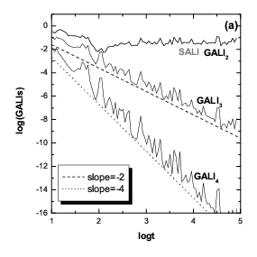
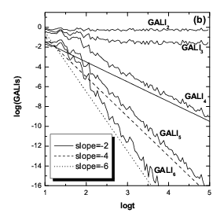
Figure 3. The GALI indices for a Hamiltonian system of (a) 2 degrees of
freedom and (b) 3 degrees of freedom. In case (a), since only GALI₂ is
constant the motion lies on a 2-dimensional torus, while in (b), where
both GALI₂ and GALI₃ are constant, the torus is 3-dimensional.

Slide 25
4. LOCALIZATION IN 1-DIMENSIONAL LATTICES
4.1 Localization in Fourier space
In 1955, by E. Fermi, J. Pasta and S. Ulam (FPU) used the computers available at the Los Alamos National Laboratory to integrate a chain of 31 nonlinear oscillators, coupled to their nearest neighbors, and investigate how energy was shared by all normal modes of the system.
To their great surprise, starting with initial conditions placed on the q =1 linear normal mode, they discovered, for small energies, a near-recurrence to their initial state after exciting very few other modes and a relatively short time, see Figure 4 (a).
This remarkable observation ran contrary to the expectation of energy sharing among all modes predicted by equilibrium statistical mechanics and was termed the “paradox” of FPU recurrences.

Slide 26
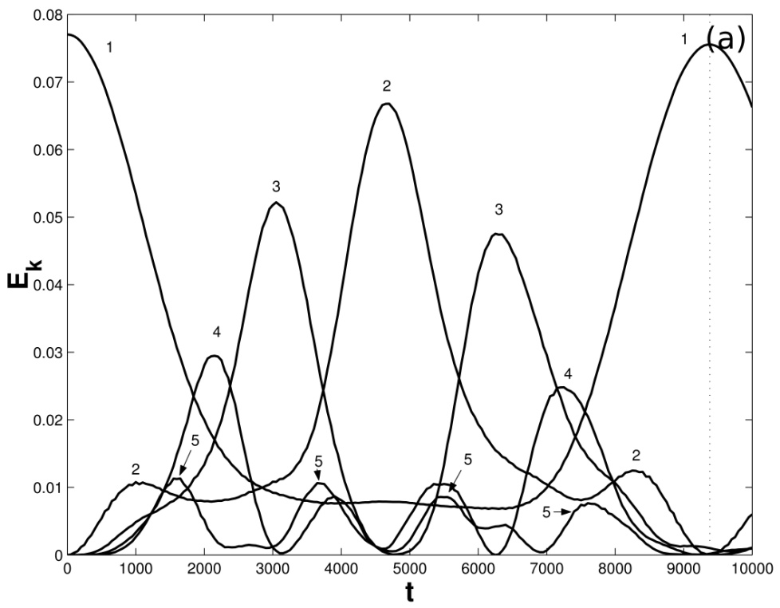
Figure 4: (a) Localization in modal space in the form of FPU recurrences, discovered by Fermi Pasta and Ulam, for a lattice of 31 particles. Note how only a packet of about 5 modes is excited before the energy returns to the q = 1 mode.

Slide 27
Energy localization” here implies localization in Fourier q-modal space, as the FPU recurrences were observed when all the energy was placed in the q=1 mode!
Flach and his co-workers in 2005 introduced the concept of q-breathers as exact periodic solutions of the problem. They showed that if we excite a single low q-breather mode the total energy remains localized only within a few of these low frequency modes, also called metastable states or natural packets.
A more complete interpretation of the FPU paradox was
provided by our group (Phys. Rev. E 81, 2010), where we
introduced the concept of q-tori, reconciling q-breathers
with the metastable packets of low-frequency modes.
Let us now use the GALI indices to study the stability of these
q – tori and the breakdown of the associated FPU recurrences!

Slide 28
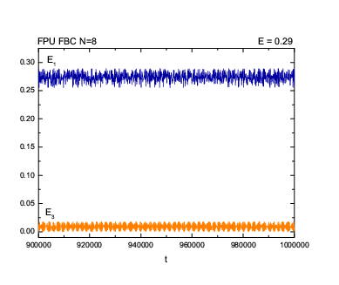
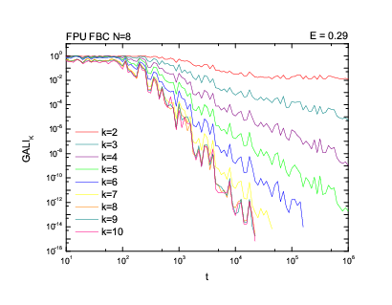
Figure 5: FPU with 8 particles: (a) Only the E₁ and E₃ modes are excited. You might think that the torus is 2-dimensional, and you are right, since (b) only GALI₂ =const. and all other GALI_{k} decay by power laws.

Slide 29
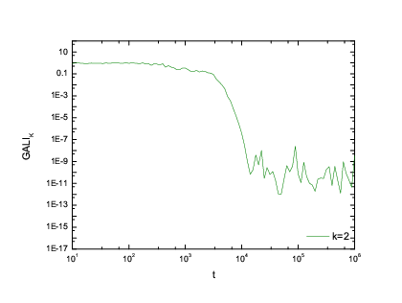
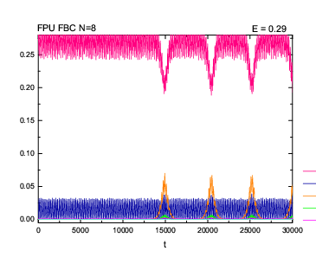
Figure 6: FPU with 8 particles and different initial conditions: (a) The evolution of GALI₂ shows already at t ≈ 500 that the orbit diffuses away from the torus weakly chaotically. (b) This becomes visible in the oscillations much later, when the recurrences break down at t ≈ 14000.

Slide 30
4.2 Localization in configuration space
It is also important to mention the localization of nonlinear lattices in their spatial coordinates (Fig. 6 below). These are exponentially localized periodic oscillations, called discrete breathers. They have been verified analytically and numerically on a variety of lattices, like the Klein-Gordon (KG) chain
(9)
- ∞ < n < ∞ , where V(x) is the on-site potential and α > 0 is a coupling parameter. Expanding in Fourier series, one finds that discrete breathers are directly related to homoclinic orbits of invertible maps, through which one can prescribe a numerical procedure for constructing them to arbitrarily high accuracy.

Slide 31
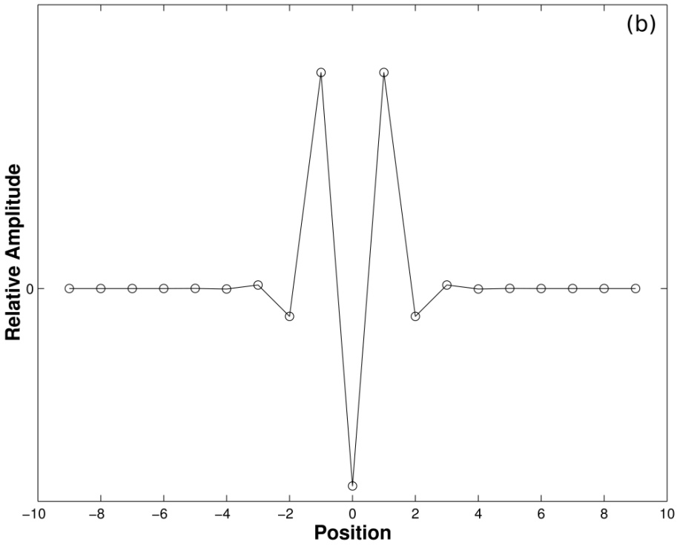
Figure 6: Localization in configuration space in the form of a discrete breather of a harmonic nearest neighbor chain with on site nonlinear potential of the Klein Gordon type.

Slide 32
Indeed, keeping only the leading term x_{n}(t)=A_{n}cos(ω_{b}t) in such an expansion one obtains the map
(10)
which provides a very good approximation for the amplitudes A_{n}, as homoclinic orbits lying at the intersections of the invariant manifolds of the saddle point at the origin of (10), at |C|>2
Discrete breathers constitute one more example of what we call Simple Periodic Orbits, with all particles oscillating with frequency ω_{b} outside the phonon band of NNMs.
Question: Does it happen that discrete breathers, when they are stable, are surrounded by low-dimensional tori? If so, it would be interesting to study the dimensionality of these tori and their stability using our GALI indices to determine if these localized solutions will eventually break down as time evolves!

Slide 33
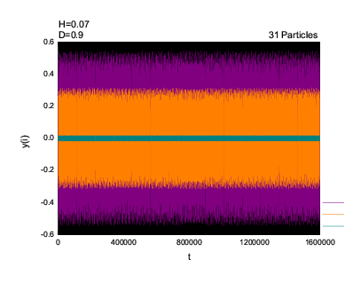
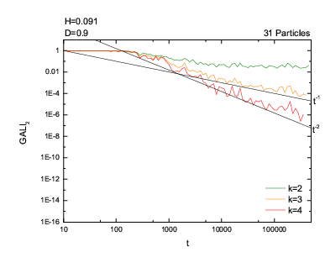
Figure 7 (STABLE TORUS): (a) The oscillations of the central three particles of a KG chain of N=31 particles do not break down, forming a quasiperiodic breather. (b) The torus is 2-dimensional, since only GALI₂ remains constant, while all other GALI_{k} decrease by power laws.

Slide 34

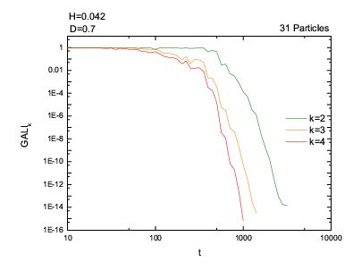
Figure 8 (UNSTABLE TORUS):(a) The oscillations of the central 3 particles, starting further from the breather, appear quasiperiodic for very long times. (b) The solution, however, is chaotic and the “torus” eventually breaks down since the GALIs decay exponentially.

Slide 35
5. COMPLEX STATISTICS OF CHAOTIC DYNAMICS
To study the statistical properties of chaotic behavior in Hamiltonian systems, we recall some basic facts of equilibrium thermodynamics. As is well-known, in Boltzmann - Gibbs statistics, if a system can be at any one of i=1,2,...,W states with probability p_{i} , its entropy is given by the famous formula
, under the constraint (11)
where k is the Boltzmann's constant. The BG entropy satisfies the property of additivity, i.e. if A and B are two independent systems, the probability to be in their union is S_{BG}(A+B) = S_{BG}(A)+S_{BG}(B). At thermal equilibrium, and for a continuum set of states depending on one variable, x, the probabilities that optimize the BG entropy subject to the constraint (11), zero mean and a given variance V is, of course, the well-known Gaussian
.
(12)

Slide 36
Another important property of the BG entropy is that it is extensive, i.e. that S_{BG}/N is finite in the limit N→∞. But, many physically important systems governed by long range interactions are neither additive nor extensive, like self-gravitating systems of finitely many mass points and ferromagnetic spin models. For such systems the so-called Tsallis entropy has been proposed (1988)
, under the constraint (13)
depending on an index q. For a continuum set of states x, the Tsallis entropy is optimized by the q-Gaussian pdf
(14)
where β=1/kT is a free parameter and a > 0 a normalization constant. Expression (14) tends to a Gaussian, as q → 1 e_{q} →e. The Tsallis entropy is not additive, and, in general, non-extensive. It offers us the possibility of studying problems whose correlations decay by power laws (not exponentially).

Slide 37
5.1 The case of multi-degree-of freedom Hamiltonian systems
There are many situations in such systems where the dynamics is weakly chaotic and may, therefore, possess Tsallis statistics of the type described above.
We found that, in the β-FPU model, near an unstable SPO1 orbit of a 5-particle chain, orbits that remain “trapped” for very long times in a thin chaotic region (see Figures 9,10) are described by pdfs of the q-Gaussian type with q ≈ 2.8, see Fig. 11(d).
These are what we call quasi-stationary states (QSS) of the dynamics. Following these states for long times, one typically finds that their pdfs pass through QSS described by q-Gaussians of smaller q ≈ 2.48, see Fig. 11(e), until they finally converge to Gaussians with q = 1, when the orbits escape to a much larger domain of strong chaos, see Fig. 11(f).

Slide 38
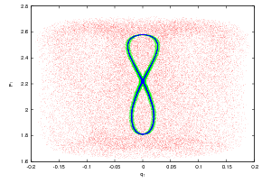
Figure 9: Three different orbits with initial conditions very close to an
unstable SPO1 orbit of the 5 particle FPU-β chain: The black “figure
eight” in the middle starts from a distance of 10⁻⁷ , the green one
around it starts within 0.0001 and the red one extending over a much
larger region, starts within 0.01 from the saddle point.

Slide 39
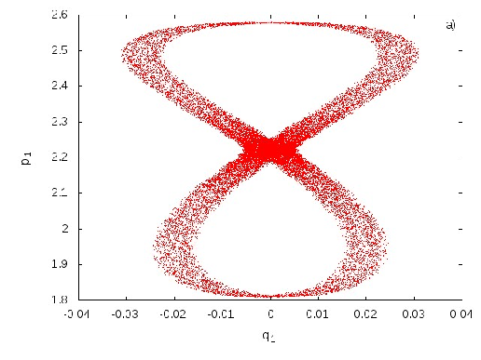
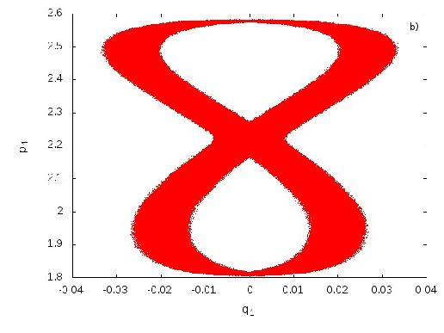
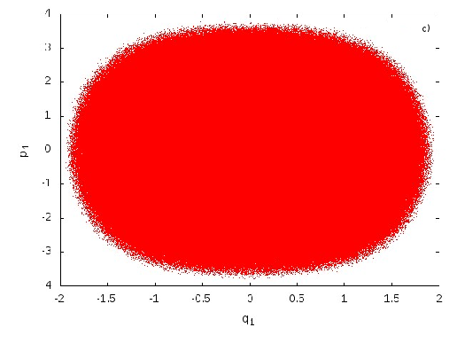
(a)
(b)
Figure 10: Orbits starting at a distance of 1.0*10⁻⁷ from the unstable SPO1 orbit, integrated for: (a) t=10⁵ (b) t=10⁷ (c) t=10⁸ eventually escape in the large chaotic sea.
(c)

Slide 40
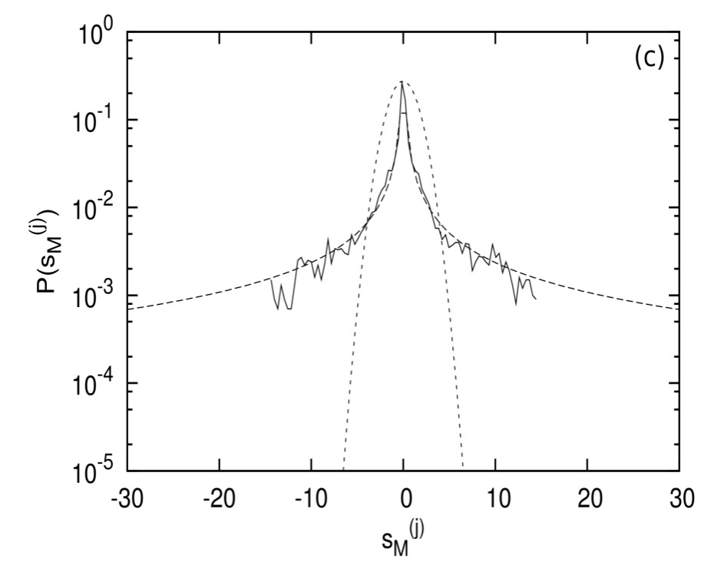
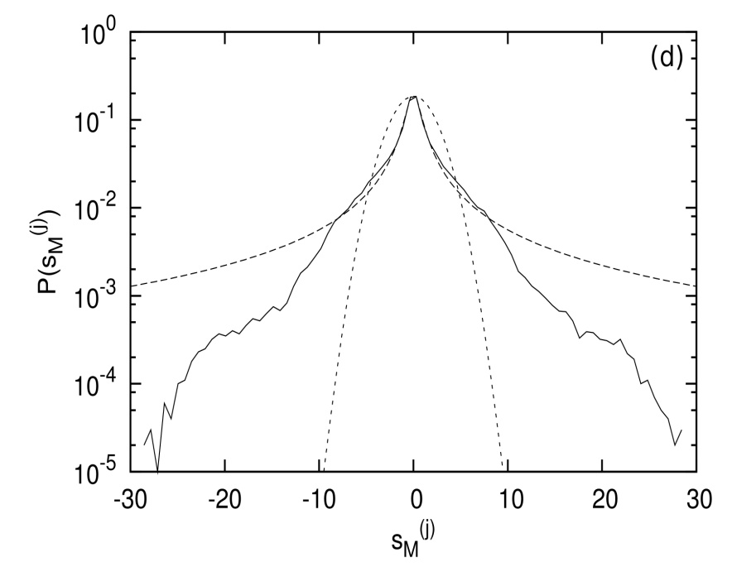
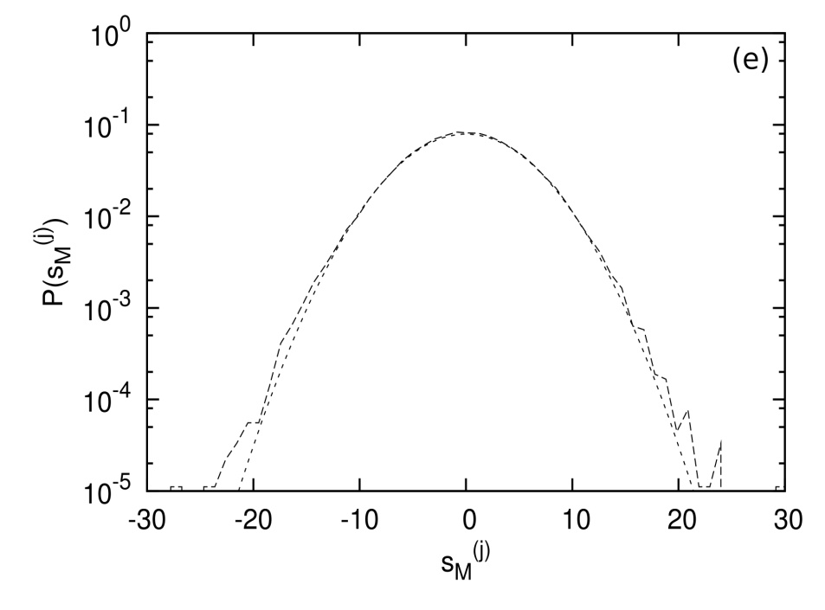
(d)
(e)
Figure 11(d – f) Plots of pdfs of position
variables for a 5- particle FPU chain and
initial conditions close to an unstable
SPO1 orbit. The QSS observed here are
well described by q-Gaussians with
(d) q = 2.78, then (e) q = 2.48, until the
orbit drifts away to a wide chaotic sea
and the pdfs converge to (f) Gaussians
with q=1.05.
(f)

Slide 41
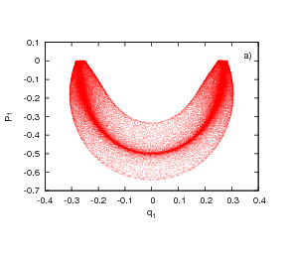
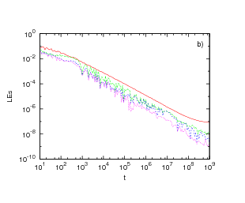
Figure 12: (a) The dynamics near an SPO2 orbit ``sticks'' to a quasiperiodic torus, at least up to t=10⁸ . The weakly chaotic nature of the motion is shown in (b), where we have plotted the 4 largest Lyapunov exponents up to t=10^9. Although they all decrease towards zero, at about t >10⁹ , the largest exponent shows a tendency to converge to a positive value, indicating that the orbit is chaotic.

Slide 42
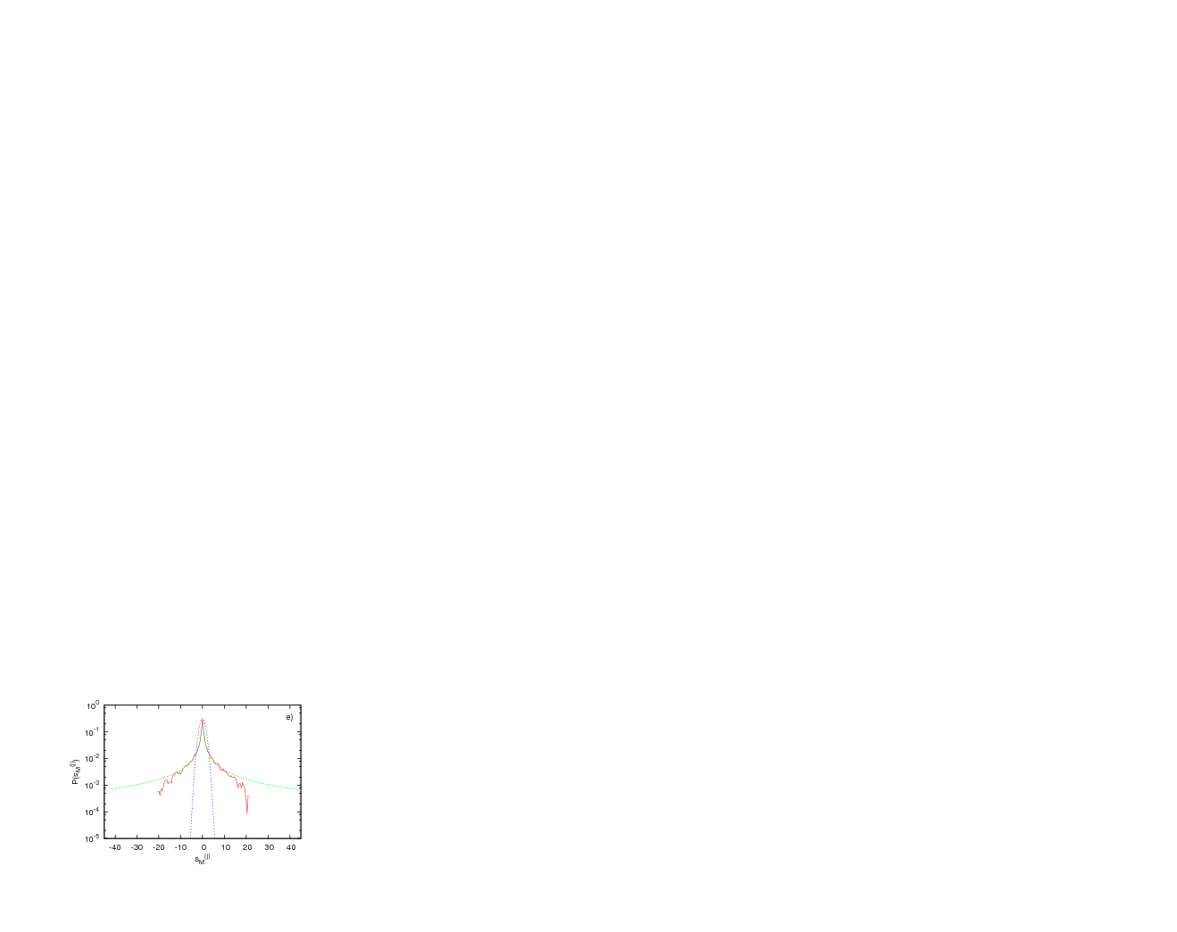
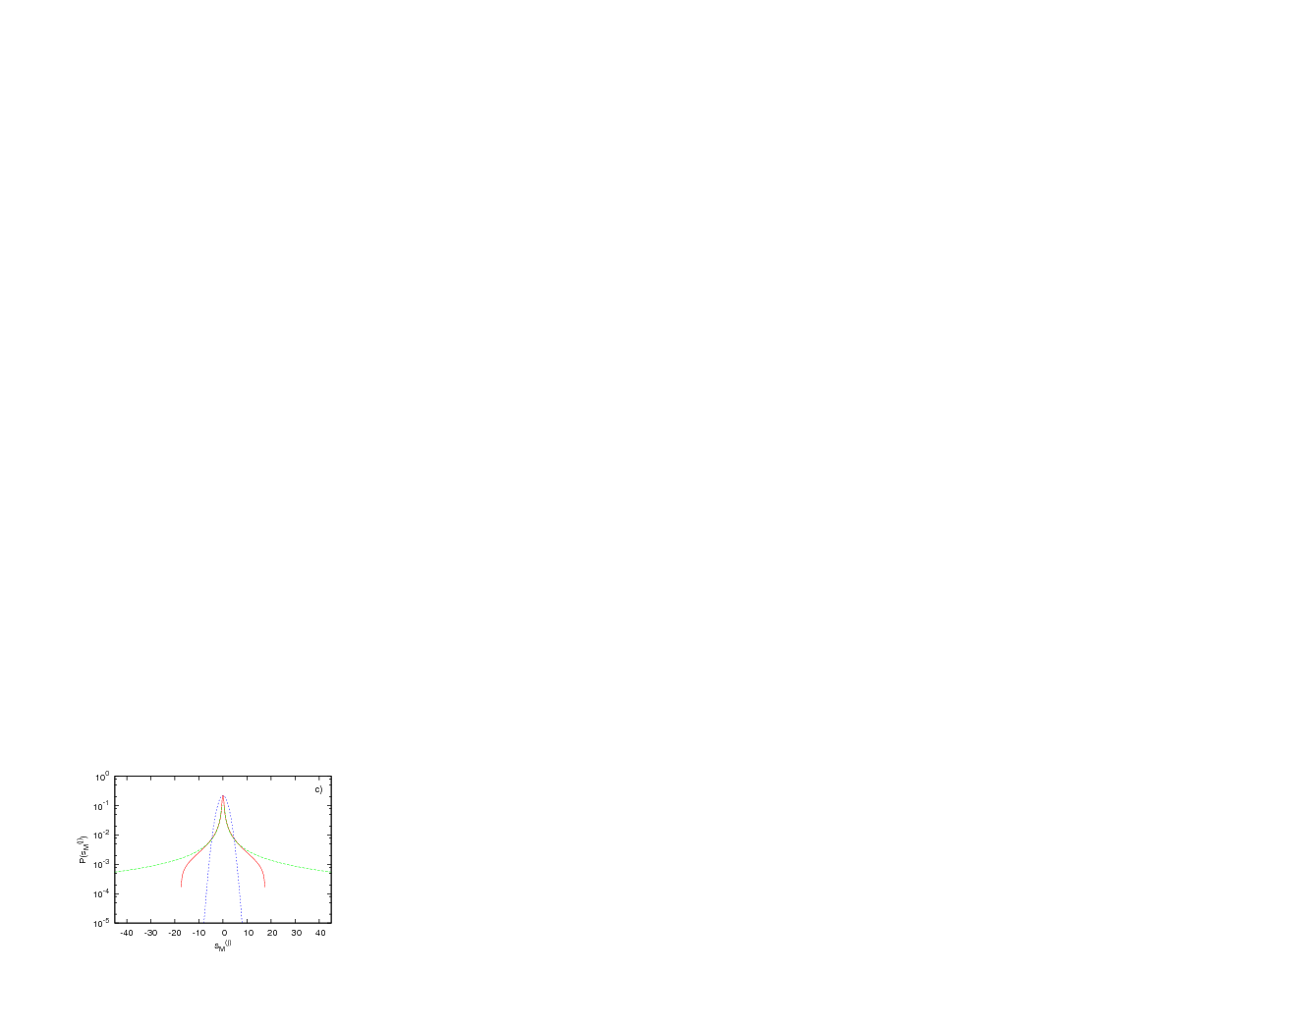
Figure 13: Left: The distribution of the normalized sum pdf of the orbit starting near SPO2, for a total integration time t=10⁶. Right: Final integration time t =10¹⁰. The pdf has converged to an almost analytical shape that is close to a q--Gaussian with q≈2.769 near the center, and seems to have an analytical form that is as yet unknown!
(Why is that? Think about it!)

Slide 43
5.2 Weak chaos in 2 – dimensional area – preserving maps
Finally we studied chaotic orbits of a 2-dimensional area – preserving maps (modeling Hamiltonian systems of 2 – degrees of freedom) called the McMillan map
n = 0,1,2,3,…. (15)
near a saddle point at the origin (μ >1). Generally, the orbits wander around the chaotic domain and pass through a sequence of q-Gaussian QSS states, with q > 1, until they become true Gaussians, with q = 1.
In some cases, however, when the chaotic domain extends around many islands where the orbits stick for long times, the pdfs appear to converge to a true q (>1)-Gaussian, for n →∞ , as shown in Figure 14.

Slide 44
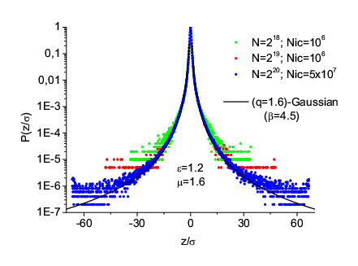
Figure 14 Left: Diffusive
motion of orbits in a thin
chaotic layer of a 2-d area –
preserving map, starting
near the unstable fixed point
at the origin, evolving to
N=2²⁰ iterations. Below: The
pdfs representing the
normalized sum of the x_{n}
coordinate of the map,
converge to a q-Gaussian
shown below, with q=1.6

Slide 45
6. The role of Long Range Interactions
Let us now consider the case where our Hamiltonian involves Long Range Interactions (LRI) as follows:
where b>0 and α ≥ 0. Note that to keep all energy terms in the Hamiltonian extensive, i.e. proportional to N, we have introduced before the quartic part of the potential the factor

Slide 46
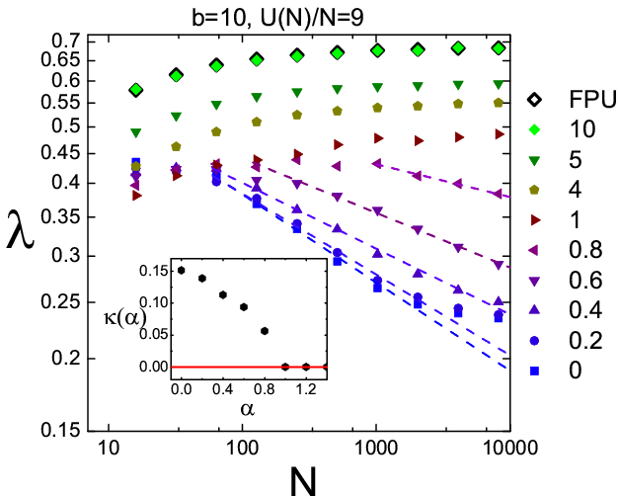
Figure 15: Τhe maximal Lyapunov exponent λ, as a function of α at fixed energy density ε=U/Ν=9. ΝΟΤΕ: For strong LRI, 0 < α < 1, λ starts to decay to zero as N increases and “weak” chaos sets in.

Slide 47
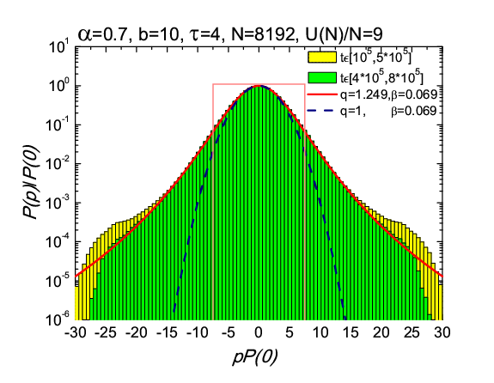
q-Gaussian : exp_{q} (p²)=(1+(1-q)p²)^{1/(1-q)} , 1< q < 3 → exp(-p²) as q→ 1
Figure 16: The momentum probability density function for LRI, α = 0.7, as time grows, converges to a q-Gaussian with q=1.249 indicating “weak” chaos (Tsallis thermostatistics) as compared to Gaussian BG statistics (strong chaos: dashed parabola).

Slide 48
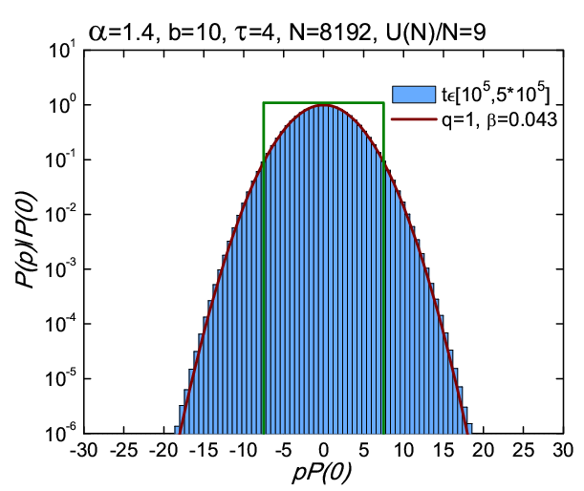
Figure 17: On the other hand, the probability density function of the momenta for Short Range Interactions (α = 1.4) quickly converges to a pure Gaussian, implying BG thermostatistics and “strong” chaos for α > 1.

Slide 49
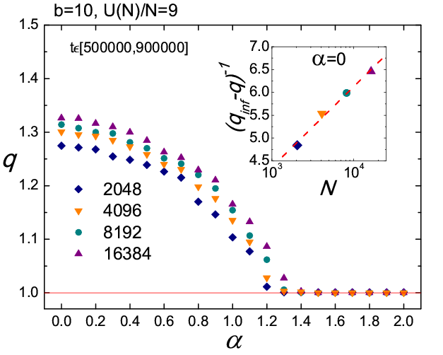
Figure 18: Note how the index q decreases to 1 over the regime of Long Range Interactions, from α = 0 to just above α = 1, where Short Range Interactions take over.

Slide 50
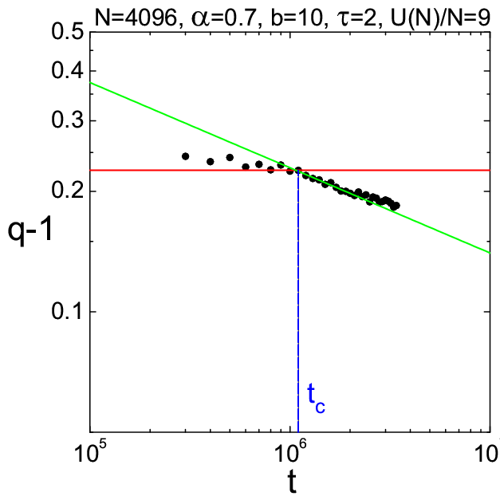
Figure 19: Important: Even for LRI (here a=0.7), there is always a time threshold t_{c} ≈ 10⁶, where the index q, starts to decrease towards “strong chaos” at q = 1 (BG prevails in the end).

Slide 51
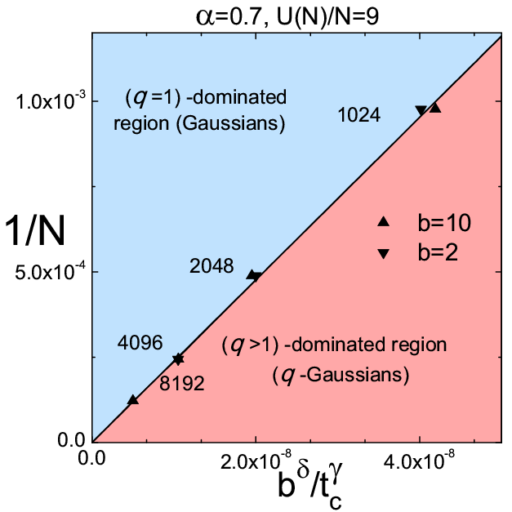
Fig. 20: With appropriate scaling a “phase transition diagram” is discovered, separating BG from Tsallis thermostatistics, where the limits t → ∞ and N → ∞ do not commute!

Slide 52
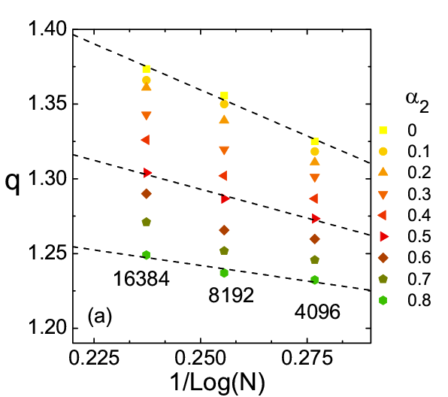
Figure 21: Important observation: The index q depends linearly on 1/ \log N for N=4096, 8192, 16384, as α₂ changes, according the following formula:
Thus, we can use this formula to estimate the asymptotic behavior of q → q∞ in the limit N → ∞ (as we saw in our Phase Diagram, Fig. 20)!

Slide 53
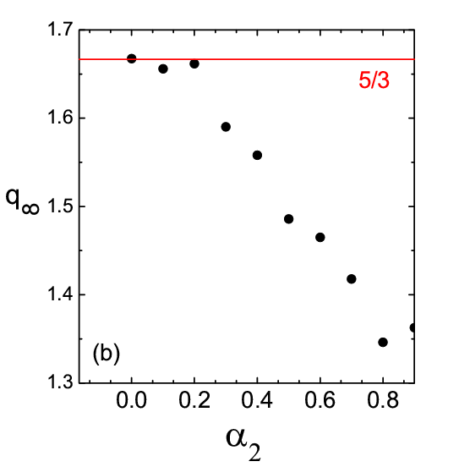
Important Conclusion:
With LRI on the nonlinear forces, we find limiting values q∞ > 1 as N → ∞ , showing that the system remains weakly chaotic in the thermodynamic limit!
Figure 22: Variation of q∞ , as α₂ changes. As α₂ → 1, and beyond, one finds that q∞ → 1 and we return to BG thermostatistics.

Slide 54
6.1 FPU 1-D Lattice with Different Ranges of Interactions on the Linear and Nonlinear Forces
We now introduce Long Range Interactions (LRI) also on the quadratic part of the potential (linear forces) as follows:
with 2 scaling exponents 0 < α₁ < ∞ and 0 < α₂ < ∞ and use the factors:
to make all terms in H proportional to N (i.e. extensive).

Slide 55
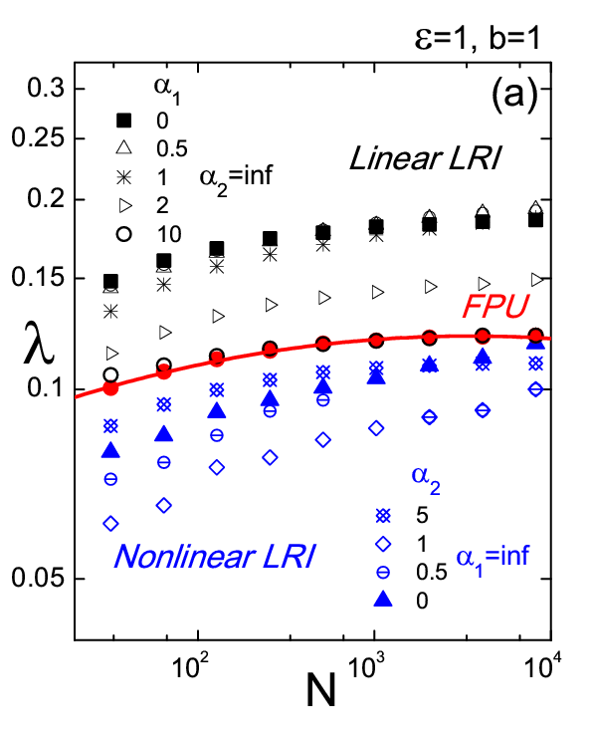
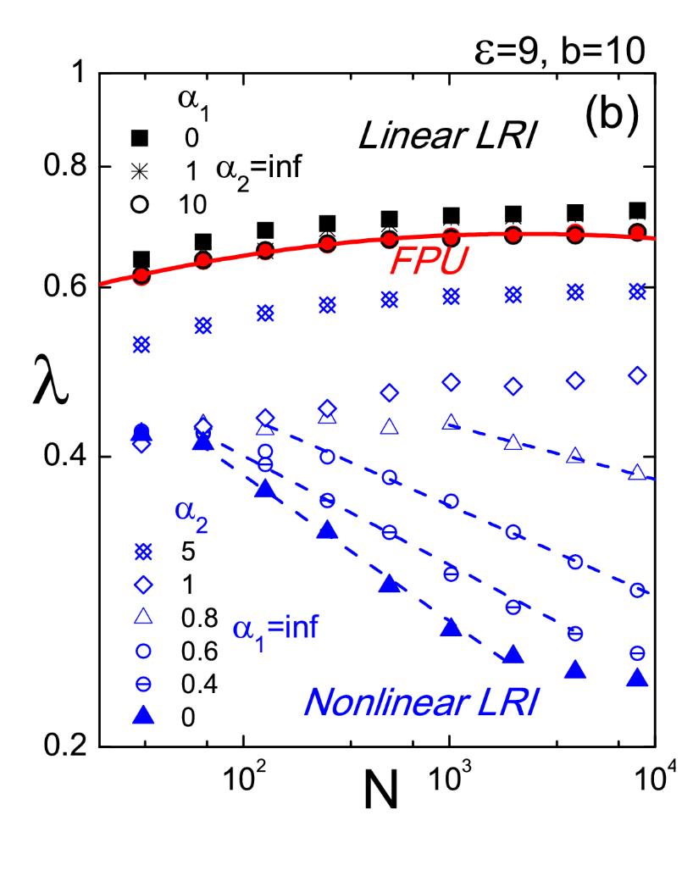
Figure 21: Log – log plots of MLE values at t = 10⁶ : (a) For increasing N, with b=1 and ε = 1, i.e. low energies and (b) as N increases with b=10 and ε = 9, i.e. high energies.

Slide 56
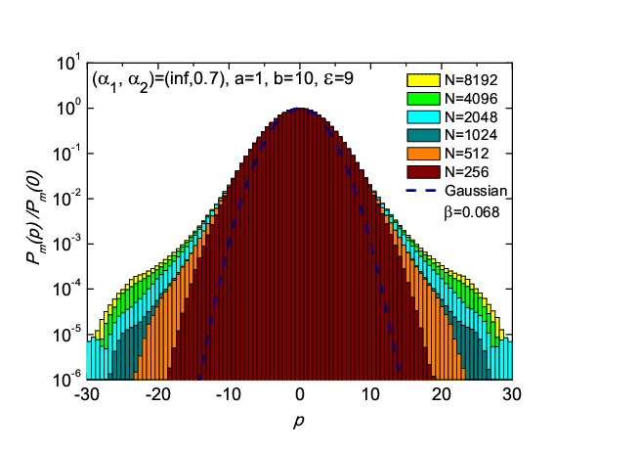
VARIATION OF MOMENTUM PDFS AS THE NUMBER OF PARTICLES GROWS:
Figure 23: Momentum distributions for the system with b = 10, ε = 9, α₂ = 0.7 and various N values. Note that as N grows the pdfs are described by a q–Gaussian whose index q increases from 1.17 for N = 512 until 1.25 for N = 8192.

Slide 57
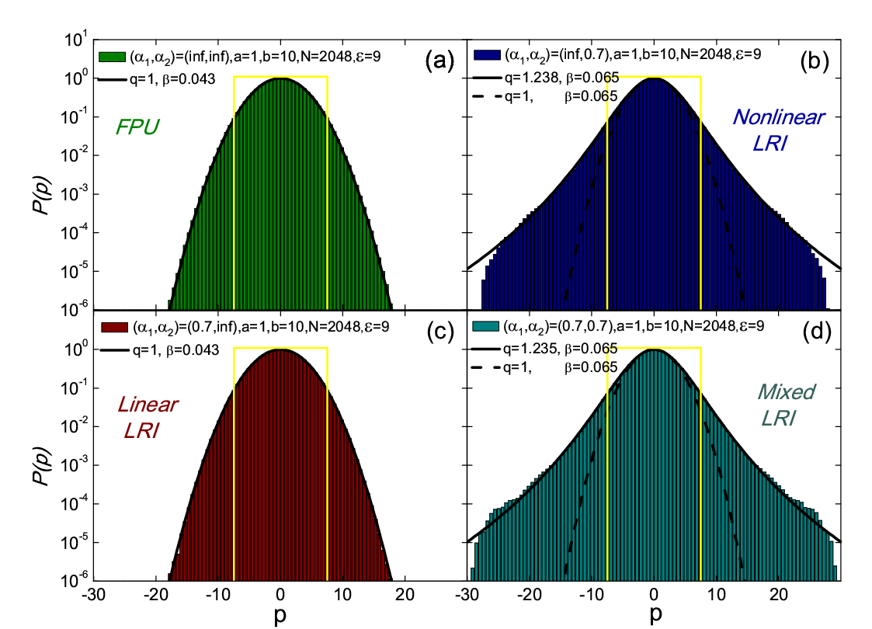
Figure 24: The momentum distributions for N=2048 particles. Upper panels: α₁ → ∞ , α₂ → ∞, i.e. FPU (left) and : α₁ → ∞ , α₂ → 0.7 (right). Lower panels: α₁ → 0.7 , α₂ → ∞ (left) and
α₁ = α₂ = 0.7 (right).

Slide 58
CONCLUSIONS (What did we learn?)
Concerning Complex Dynamics of FPU 1-D Latiices:
We “described how important Simple Periodic Orbits (SPOs) are in exploring “weak” and “strong” chaos, depending on the energy density E_{c}/N > 0 at which they first become unstable.
We mentioned the significance of Lyapunov spectra in quantifying strong chaos, and introduced the GALI_{k} spectrum of indices k=2,3,4,…, best suited for identifying chaos, when they vanish exponentially and quasiperiodic motion, when they decay as power laws, whose powers yield the dimensionality of the torus.
We used the GALI indices to study the breakdown of localization in 1-dimensional lattices: (i) In modal space connected to FPU recurrences and (ii) in position space, occurring in the form of discrete breathers.

Slide 59
Concerning Complex Statistics of FPU 1-D Lattices:
When Long Range Interactions are imposed (LRI) only on the nonlinear forces (V₄) – no matter what the linear forces are doing – we obtain weakly chaotic motion characterized by q-Gausian pdfs with q>1 (Tsallis thermodynamics).
In the LRI case, we find a “phase transition diagram”, separating BG from Tsallis thermostatistics, in which the limits
t → ∞ and N → ∞ do not commute!
3. When we introduce LRI only on the linear forces (V₂) we obtain
strongly chaotic motion demonstrated by pure Gausian pdfs with
q = 1 (Boltzmann Gibbs thermodynamics).
4. When LRI are imposed on the nonlinear forces, we find limiting
values q∞ > 1 as N → ∞ , showing that the system remains
weakly chaotic (Tsallis and NOT Boltzmann Gibbs) in the
thermodynamic limit!

Slide 60
7. LRI and Localization in 1-D Lattices with On Site Potential
Let us now turn to the study of the effect of LRI on the chaotic and statistical properties of 1 – D Lattices with onsite potentials (with Helen Christodoulidi and L. Drossos, EPJST 227 (5,6) 2018).
The first one is of the Klein Gordon (KG) type and involves quadratic interparticle interactions:
The second is referred to as Gordbach-Flach (GF) and involves only quartic interparticle interactions:
It was first reported in A.V. Gorbach, S. Flach, Phys. Rev. E 72, 056607 (2005) and also studied in P. Maniadis, T. Bountis, Phys. Rev. E 73, 046211 (2006).

Slide 61


Note that these systems have the general Nearest Neighbor form:
In this work, we will study them in the Long Range Interaction (LRI) form:
Where, as before, the constant $\tilde{N}$ is introduced to make all terms in the Hamiltonian extensive:
In fact, here we will only consider the case of maximal LRI where α = 0, where $\tilde{N}=N−1 .$

Slide 62
Under Nearest – Neighbor Interactions these systems are known to support discrete breathers (DB) of the usual form:
Let us see now what form these DB take under LRI:
Fig. 25: Time evolution of the normalized on site energies in (a) the NN KG and (b) the GF NN model, (c) the KG under LRI and (d) the GF under LRI. N = 256, C = 1 and only the central particle is given p₀(0) = 0.2 .

Slide 63
To better understand the results that follow concerning the chaotic behavior of these systems let us observe that their equations of motion take the form:
where p = 1 for KG and p = 3 for GF.
Observe now that these equations take the simpler form:
where x₀ represents the oscillations of the n = 0 particle, while all others oscillate as x(t) for all n =±1,±2 ±3 ….
Considering small initial oscillations of the form x₀(t)=Asinωt,
x(t)=B cosωt, we find in the limit of large N:
where
with
and B = - A/(N-1).
These results are well confirmed by numerical computations.

Slide 64
LRI suppresses Chaos in KG and GF 1-D Lattices
Figure 26. The maximal Lyapunov exponent λ for increasing energy density values
ε = E/N and N = 2048. (a) The NN KG (blue diamonds) and the LRI KG model (red circles). (b) The NN GF model (blue diamonds) and the LRI GF model (red circles).
Figure 27. The maximal Lyapunov exponent λ for increasing number of particles N at fixed ε = 1. (a) The NN KG (blue diamonds) and the LRI KG model with LRI (red circles). (b) The NN GF model (blue diamonds) and the LRI GF model (red circles).

Slide 65
Momentum Probability Distributions of KG and GF 1-D Lattices
are closer to q-Gaussians under LRI (α = 0)
Fig. 28. Time-averaged momentum pdfs with N=2048 and ε=10 in the (a) KG, (b) GF ΝΝ cases are pure Gaussians (“strong chaos”), but are quite different in the LRI case of (c) KG, while in the (d) GF LRI case they are better fitted by q>1 Gaussians related to weak chaos.

Slide 66
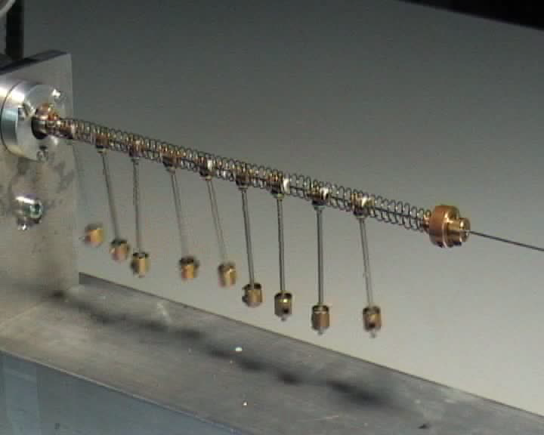
8. Supratransmission of Energy occurs at higher
thresholds for LRI, down to α ≈ 2
(Work with J. Macias-Diaz, H. Christodoulidi, AIMS (April 2019)
We begin with the Hamiltonian:
Where, again, to keep all terms proportional to N:
Our equations of motion are:
With boundary and initial conditions:

Slide 67
The γ_{n} > 0 damping coefficients serve to avoid waves “reflecting off” the right boundary, while for suitable values of Ω, within the “forbidden band”, 0 < Ω < 1, it is known for α = ∞ that
the supratransmission threshold is given by the formula:
(F. Geniet and J. Leon, P R L, 89(13):134102, 2002). Using now a fractional derivative formulation, we can obtain a PDE form of the equations of motion as:
where we have used the well-known Riesz fractional partial derivative of x of order ν−1 with respect to x.

Slide 68
Substituting now linear waves in our PDE,
we obtain the dispersion relation
Hence we expect that our system has a forbidden band 0 < Ω < 1.
It is very interesting that the above result is in agreement with an analytical result obtained very recently (Beukam, Nguenang, Trombettoni, Dauxois, Khomeriki, and Ruffo, CNSNS, 60(1):115–127, 2018):
In fact, for α > 1, the above ω²(k) does not reach values much bigger than 1, which explains why our driving frequencies 0.7≤ Ω ≤1 yielding supratransmission truly belong to a forbidden gap of the system, where even the harmonics nΩ, n=2,3,… cannot excite linear modes!

Slide 69
(a)
(b)
Fig. 29: Suprastransmission threshold A_{s} vs. Ω values for α=∞: (a) analytical vs. numerical result (1) and (b) the occurrence of the supratransmission, viewed as a sharp increase of the total Energy for A > A_{s} .

Slide 70
Fig. 30: Upper row: α = 10, (left) A = 3.30 (right) A = 3.31
Middle row: α = 3, (left) A = 3.49 (right) A = 3.50
Bottom row: α = 2, (left) A = 4.60 (right) A = 4.61,
N=100 particles. Observe how A_{s} increases as α decreases!

Slide 71
8.2 Surprise: For a < 2, supratransmission thresholds
sharply decrease to much lower values!
a =3
a = 2
Fig. 31. Graphs of the supratransmission thresholds versus Ω, for α =3 and α = 2. The solid curve is the short range interaction formula (1), (that fails badly) the dashed lines are the numerical approximations, and the dotted curve is the plot of the empirical formula
for suitable k, r fitting parameters.

Slide 72
The surprise occurs for stronger LRI, i.e. 0 ≤ α < 2 !!!
Α_{s}
α
Fig. 32: The supertransmission threshold A_{s} as a function of α for Ω = 0.9 (red diamonds), Ω = 0.8 (blue circles) and Ω = 0.7 (green triangles). As α decreases below 2, the theresholds take a sudden “dive” to lower values that is not predicted by our empirical formula (2).

Slide 73
This decrease is a mystery that we have not been able to explain. It is most likely related to the fact that our potentials, which beyond the linear particle - particle interactions, also include on site potentials.
Α_{s}
α
Fig. 33: The supertransmission threshold A_{s} as a function of α for Ω = 0.9, Ω = 0.8 and Ω = 0.7. Numerical results on the left are to be compared with our improved empirical formula (3), shown below.
for suitable κ₁, κ₂ , κ₃ and λ > 0 fitting parameters.

Slide 74
5. Conclusions
When Long Range Interactions are imposed (LRI) only on the nonlinear forces (V₄) – no matter what the linear forces are doing – we obtain weakly chaotic motion characterized by q-Gausian pdfs with q>1 (Tsallis thermostatistics).
In the LRI case, we find a “phase transition diagram”, separating BG from Tsallis thermostatistics, in which the limits
t → ∞ and N → ∞ do not commute!
3. When we introduce LRI only on the linear forces (V₂) we obtain
strongly chaotic motion exhibiting pure Gausian pdfs with
q = 1 (Boltzmann Gibbs thermostatistics).
4. When LRI are imposed on the nonlinear forces, we find limiting
values q∞ > 1 as N → ∞ , showing that the system remains
weakly chaotic (Tsallis and NOT Boltzmann Gibbs) in that limit!
5. We studied the effect of Supratransmission and found that under LRI,
significantly higher threshold amplitudes are required for excitation.
6. When On – Site Potentials are present, LRI also imposes higher
thresholds for Supratransmission, but down to α ≤ 2 (WHY?)

Slide 75
References
1. J. Bergamin, T. Bountis and C. Jung, "A Method for Locating Symmetric Homoclinic Orbits Using Symbolic Dynamics", J. Phys. A: Math. Gen., 33 , 8059-8070 (2000).
2. J. Bergamin, T. Bountis and M. Vrahatis, "Homoclinic Orbits of Invertible Maps", Nonlinearity 15, 1603 – 1619 (2002).
3. Skokos, Ch., Bountis, T., Antonopoulos, C. (2007), Geometrical properties of local dynamics in Hamiltonian systems: The generalized alignment index (GALI) method, Physica D231, 30—54.
4. Skokos, Ch., Bountis, T., Antonopoulos, C (2008), Detecting chaos, determining the dimensions of tori and predicting slow diffusion in Fermi Pasta-Ulam lattices by the generalized alignment index method. Eur. Phys. J. Sp. Top. 165, 5—14.
5. Christodoulidi, H., Efthymiopoulos, C., Bountis, T (2010), Energy localization on q-tori, long-term stability, and the interpretation of Fermi-Pasta-Ulam recurrences, Phys. Rev. E 81, 016210.
6. Antonopoulos, C., Bountis, T., Basios, V. (2011), Quasi-stationary chaotic states of multidimensional Hamiltonian systems, Physica A 390, 3290—3307.

Slide 76
7. Ruiz Lopez G., Bountis, T. and Tsallis, C. (2012), “Time – Evolving Statistics of Chaotic Orbits in Conservative Maps in the Context of the Central Limit Theorem”, Intern. J. Bifurc. Chaos, Vol. 22 (9), pp. 12502.
8. Bountis T. and Skokos, H. (2012), Complex Hamiltonian Dynamics, Springer Synergetics series, Springer, Berlin.
9. Christodoulidi, H., Tsallis, C., Bountis, T (2014), “Fermi-Pasta-Ulam model with long-range interactions: Dynamics and thermostatistics”, EPJ Letters, 108, 40006 (2014) .
10. H. Christodoulidi, . Bountis, C. Tsallis and L. Drossos, “Chaotic Behavior of the Fermi-Pasta-Ulam Model with Different Ranges of Particle interactions”, J. Stat. Mech. 12 (12) (2016) 123206.

Slide 77
References:
H. Christodoulidi, C. Tsallis and T. Bountis, “Fermi-Pasta-Ulam model with long range interactions: Dynamics and thermostatistics”, European Physics Journal Letters EPL, 108, 40006 (2014).
H. Christodoulidi, T. Bountis, C. Tsallis and L. Drossos, “Chaotic Behavior of the Fermi-Pasta-Ulam Model with Different Ranges of Particle interactions”, J. Stat. Mech. 12 (12) (2016) 123206.
H. Christodoulidi, A. Bountis and L. Drossos, “The Effect of Long--range Interactions on the Dynamics and Statistics of 1D Hamiltonian Lattices with On--Site Potential”, EPJST 227 (5,6) 563 (2018).
J. C. Macias Diaz, A. Bountis, “On the Transmission of Energy in β-Fermi–Pasta–Ulam Chains with Diﬀerent Ranges of Particle Interactions”, CNSNS, vol. 63 (2018) 307–321 (2018).
J. E. Macias-Diaz, A. Bountis, H. Christodoulidi, “On the Transmission of Energy in Hamiltonian Systems with Globally Interacting Particles and On-Site Potentials”, AIMS Journal of Mathematics and Engineering (April 2019).

Slide 78
References
Bountis T. and Skokos, H. (2012), Complex Hamiltonian Dynamics, Springer Synergetics series, Springer, Berlin.
Christodoulidi, H., Tsallis, C., Bountis, T (2014), “Fermi-Pasta-Ulam model with Long Range interactions: Dynamics and Thermostatistics”, EPJ Letters, 108, 40006 (2014) .
H. Christodoulidi, T. Bountis, C. Tsallis and L. Drossos, (2016), “Chaotic Behavior of the Fermi-Pasta-Ulam Model with Different Ranges of Particle interactions”, J. Stat. Mech. 12 (12) 123206 (2016).
H. Christodoulidi, A. Bountis and L. Drossos, (2018) “The Effect of Long- Range Interactions on the Dynamics and Statistics of 1-D Hamiltonian Lattices with On--Site Potential”, to appear in EPJST (2018).
J. C. Macias Diaz, A. Bountis, (2018) “On the Transmission of Energy in β-Fermi–Pasta–Ulam Chains with Diﬀerent Ranges of Particle Interactions”, CNSNS, vol. 63 (2018) 307–321 (2018).
J. E. Macias-Diaz, A. Bountis, H. Christodoulidi (2019), “Energy Transmission in Hamiltonian Systems with Globally Interacting Particles and On-Site Potentials”, AIMS Journal of Mathematics and Engineering (April, 2019).

