Slide 1
Introduction to
Categories & Functors
Pim de Haan
PhD student @ University of Amsterdam
Research associate @ Qualcomm AI Research*, Qualcomm Technologies Netherlands B.V.
July 25, 2022
@First Italian School in Geometric Deep Learning
*an initiative of Qualcomm Technologies Inc.

Slide 2



Functions of sets
Fuction $f$ from a set $X$ to a set $Y$, written $f:X→Y$
Defined by choosing for each $x∈X$, an element $f(x)∈Y$

Slide 3




Function composition
Defines a function $g∘f:X→Z$ mapping $x∈X$ to $g\left(f\left(x\right)\right)∈Z$

Slide 4
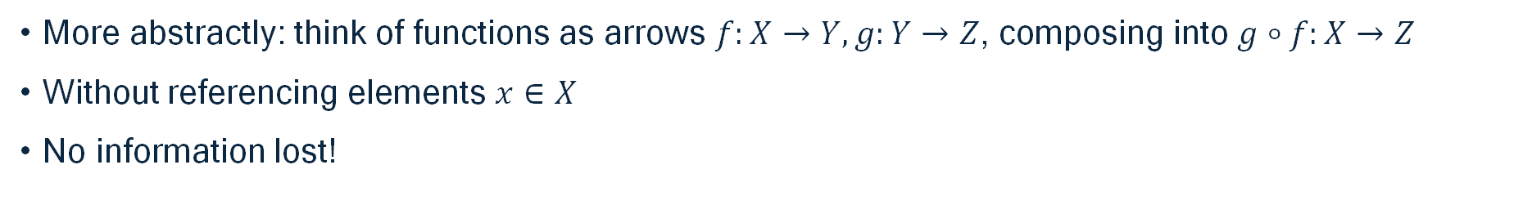


Functions as arrows
More abstractly: think of functions as arrows $f:X→Y, g:Y→Z$, composing into $g∘f:X→Z$
Without referencing elements $x∈X$
No information lost!

Slide 5
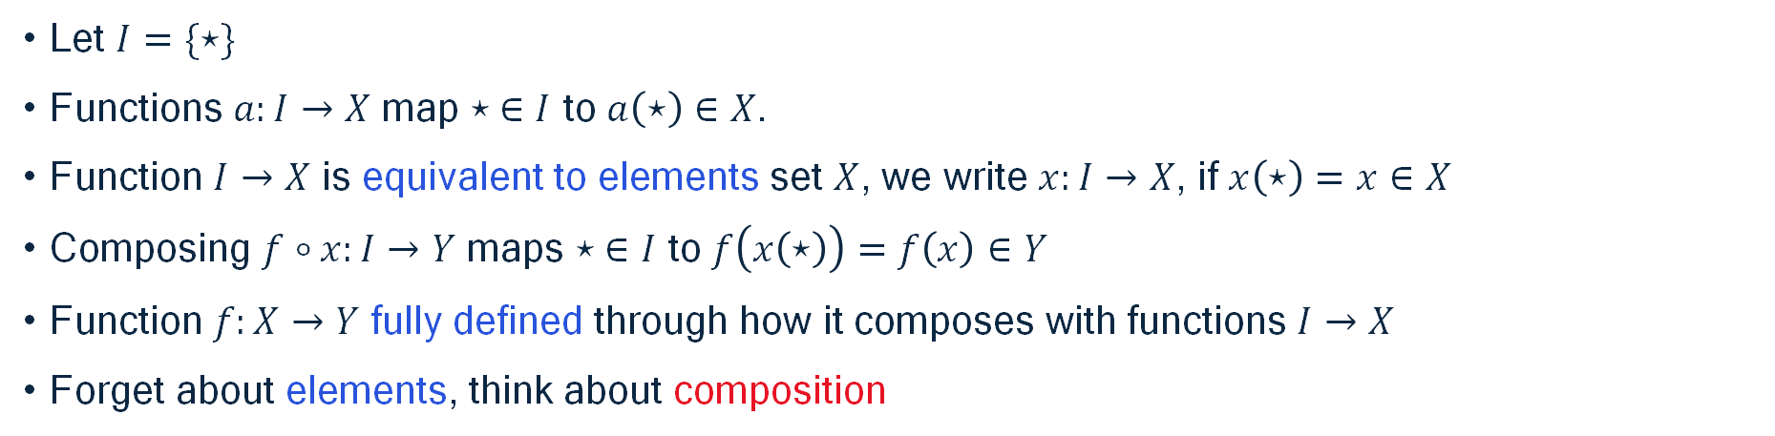
Reconstructing elements
Let $I=\{⋆\}$
Functions $a:I→X$ map $⋆ ∈I$ to $a\left(⋆\right)∈X$.
Function $I→X$ is equivalent to elements set $X$, we write $x:I→X$, if $x\left(⋆\right)=x∈X$
Composing $f∘x:I→Y$ maps $⋆ ∈I$ to $f\left(x\left(⋆\right)\right)=f\left(x\right)∈Y$
Function $f:X→Y$ fully defined through how it composes with functions $I→X$
Forget about elements, think about composition

Slide 6









Key properties of function composition
Associativity
$h∘\left(f∘g\right)=\left(h∘f\right)∘g$
Every set $X$ has special arrow ${id}_{X}:X→X$
Such that
$f={id}_{Y}∘f=f∘{id}_{X}$

Slide 7



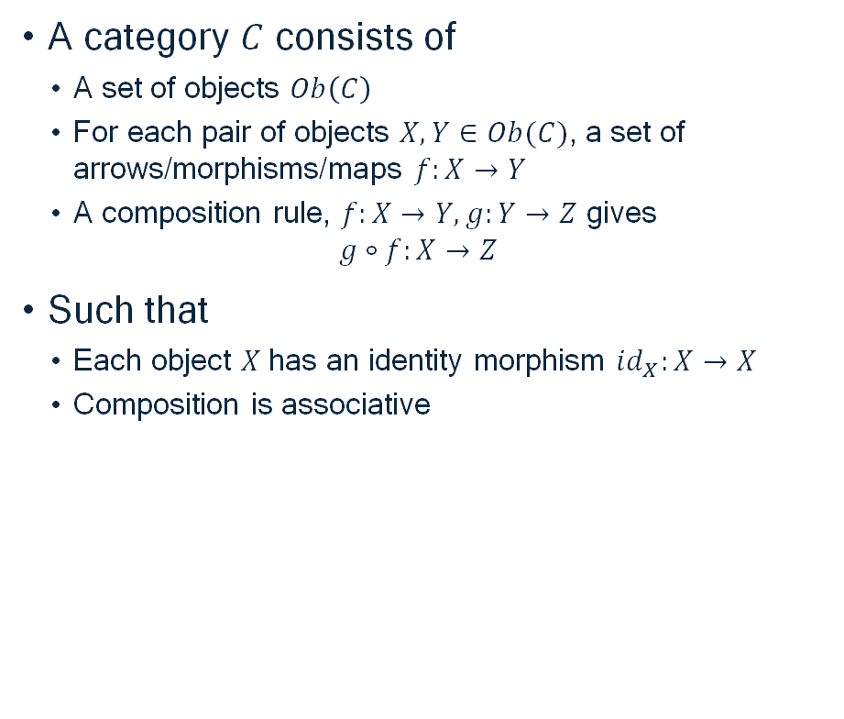





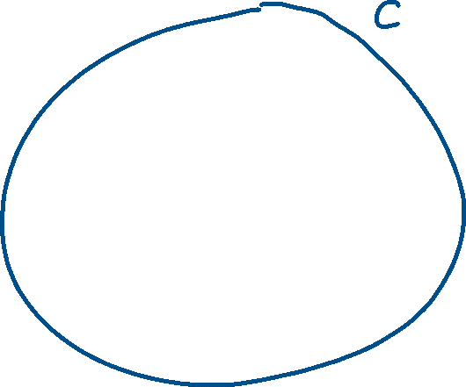

Category
A category $C$ consists of
  A set of objects $Ob\left(C\right)$
  For each pair of objects $X, Y∈Ob(C)$, a set of arrows/morphisms/maps $f:X→Y$
  A composition rule, $f:X→Y,g:Y→Z$ gives
  $g∘f:X→Z$
Such that
  Each object $X$ has an identity morphism $id_{X}:X→X$
  Composition is associative

Slide 8



Category
A category $C$ consists of
  A set of objects $Ob\left(C\right)$
  For each pair of objects $X, Y∈Ob(C)$, a set of arrows/morphisms/maps $f:X→Y$
  A composition rule, $f:X→Y,g:Y→Z$ gives
  $g∘f:X→Z$
Such that
  Each object $X$ has an identity morphism $id_{X}:X→X$
  Composition is associative

Slide 9

Function-like categories
$Set$
  Objects are sets
  Morphisms are functions
        $Vec$
  Objects are vector spaces
  Morphisms are linear maps
$Mat$
  Objects are natural numbers, $n$ corresponding to $ℝ^{n}$
  Morphisms are matrices, $f:n→m$ is a matrix $f∈ℝ^{m × n}$
$Top$
  Objects are topological spaces
  Morphisms are continuous functinos
$Group$
  Objects are groups
  Morphisms are group homomorphisms

Slide 10

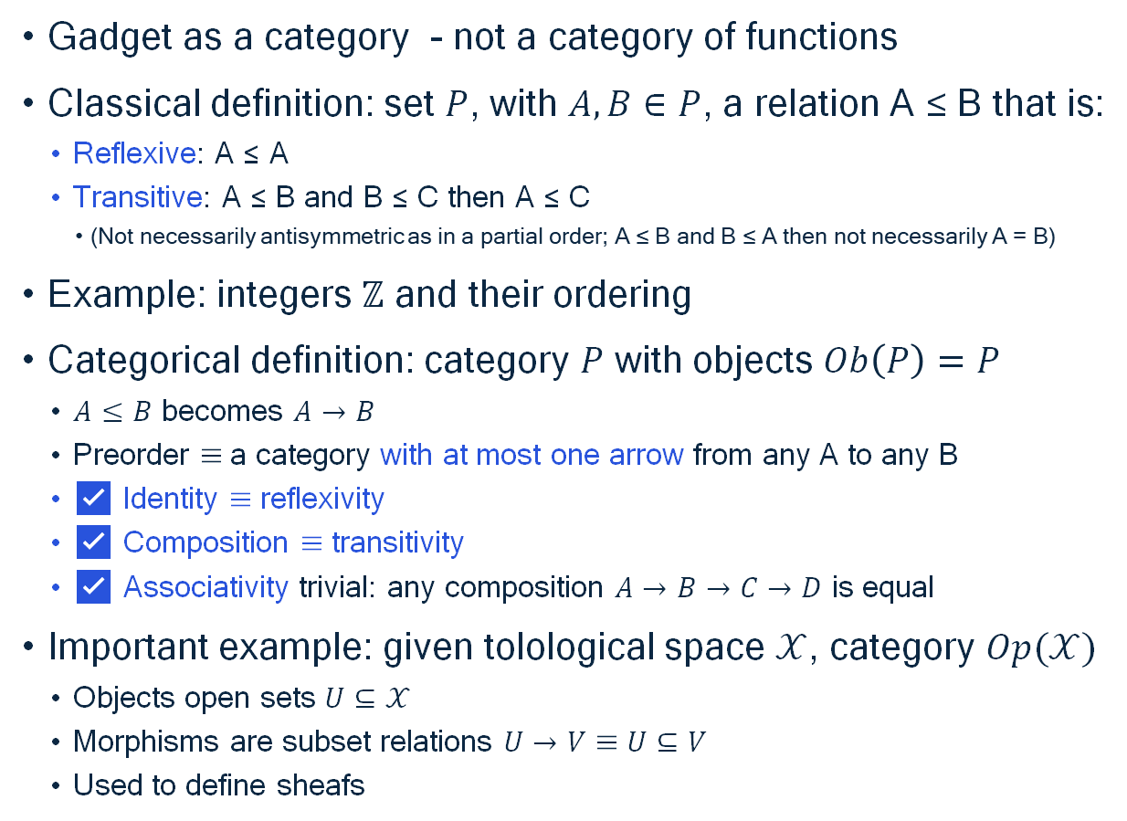
Preorders as Categories
A
X
Y
Gadget as a category - not a category of functions
Classical definition: set $P$, with $A,B∈P$, a relation A ≤ B that is:
  Reflexive: A ≤ A
  Transitive: A ≤ B and B ≤ C then A ≤ C
    (Not necessarily antisymmetric as in a partial order; A ≤ B and B ≤ A then not necessarily A = B)
Example: integers $ℤ$ and their ordering
Categorical definition: category $P$ with objects $Ob\left(P\right)=P$
  $A≤B$ becomes $A→B$
  Preorder $≡$ a category with at most one arrow from any A to any B
  ✅ Identity $≡$ reflexivity
  ✅ Composition $≡$ transitivity
  ✅ Associativity trivial: any composition $A→B→C→D$ is equal
Important example: given tolological space $𝒳$, category $Op(𝒳)$
  Objects open sets $U⊆𝒳$
  Morphisms are subset relations $U→V≡U⊆V$
  Used to define sheafs
P
C
B
E
D
Z
A
X
Y
P
C
B
E
D
Z

Slide 11



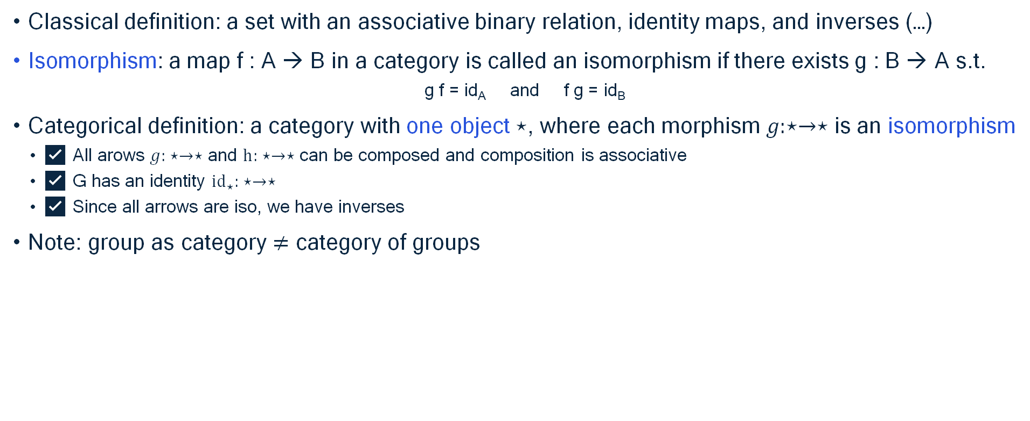
Groups as Categories
Classical definition: a set with an associative binary relation, identity maps, and inverses (…)
Isomorphism: a map f : A → B in a category is called an isomorphism if there exists g : B → A s.t.
  g f = id_{A} and f g = id_{B}
Categorical definition: a category with one object $⋆$, where each morphism $g:⋆→⋆$ is an isomorphism
  ✅ All arows $g: ⋆→⋆$ and $h: ⋆→⋆$ can be composed and composition is associative
  ✅ G has an identity ${id}_{⋆}: ⋆→⋆$
  ✅ Since all arrows are iso, we have inverses
Note: group as category $≠$ category of groups
G
$$⋆$$

Slide 12


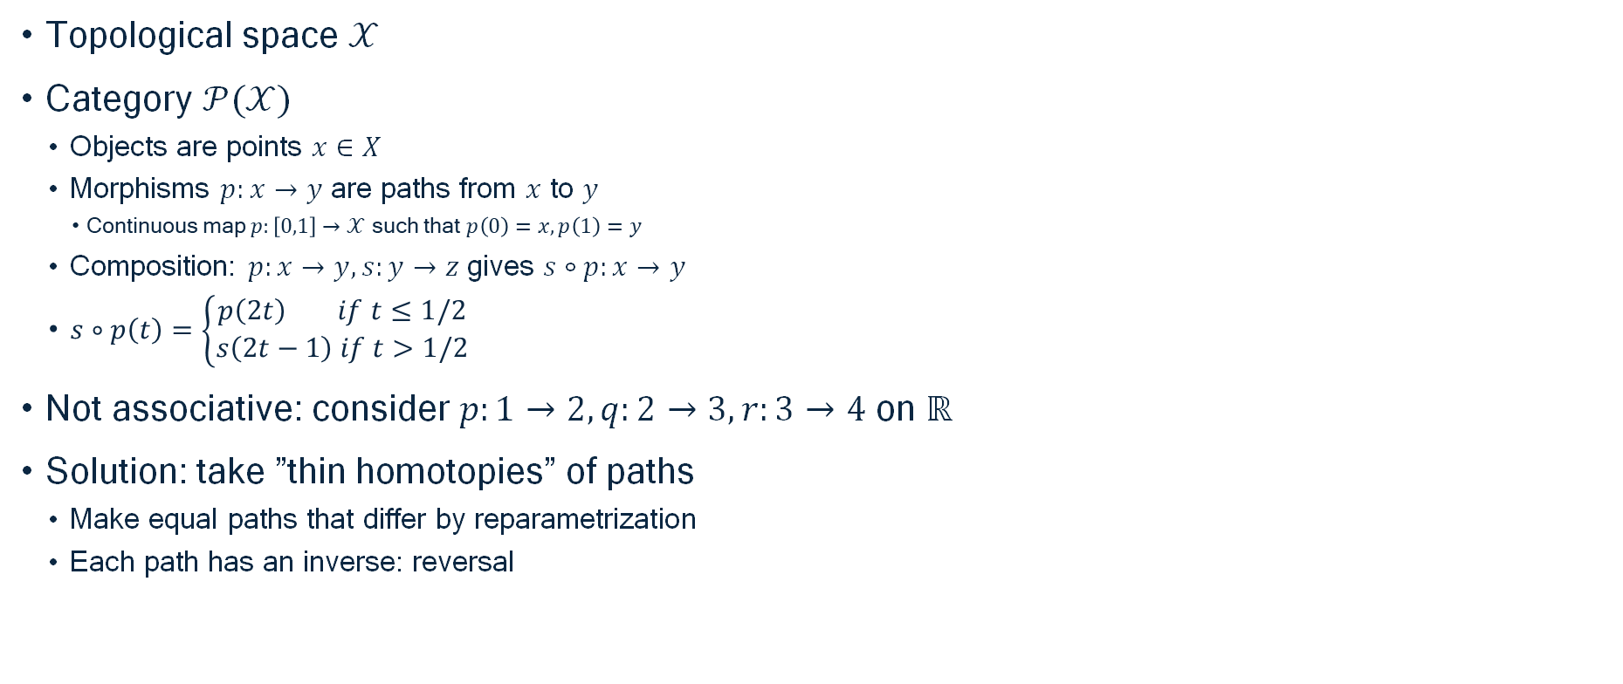


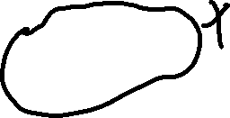






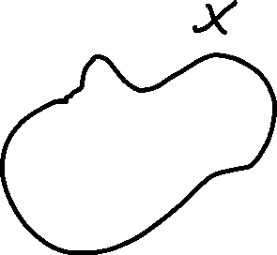

Path category
Topological space $𝒳$
Category $𝒫(𝒳)$
  Objects are points $x∈X$
  Morphisms $p:x→y$ are paths from $x$ to $y$
    Continuous map $p:\left[0,1\right]→𝒳$ such that $p\left(0\right)=x,p\left(1\right)=y$
  Composition: $p:x→y, s:y→z$ gives $s∘p:x→y$
  $s∘p\left(t\right)=\left\{\begin{aligned}p\left(2t\right) if t≤1/2 \\ s\left(2t−1\right) if t>1/2\end{aligned}\right.$
Not associative: consider $p:1→2, q:2→3, r:3→4$ on $ℝ$
Solution: take ”thin homotopies” of paths
  Make equal paths that differ by reparametrization
  Each path has an inverse: reversal

Slide 13
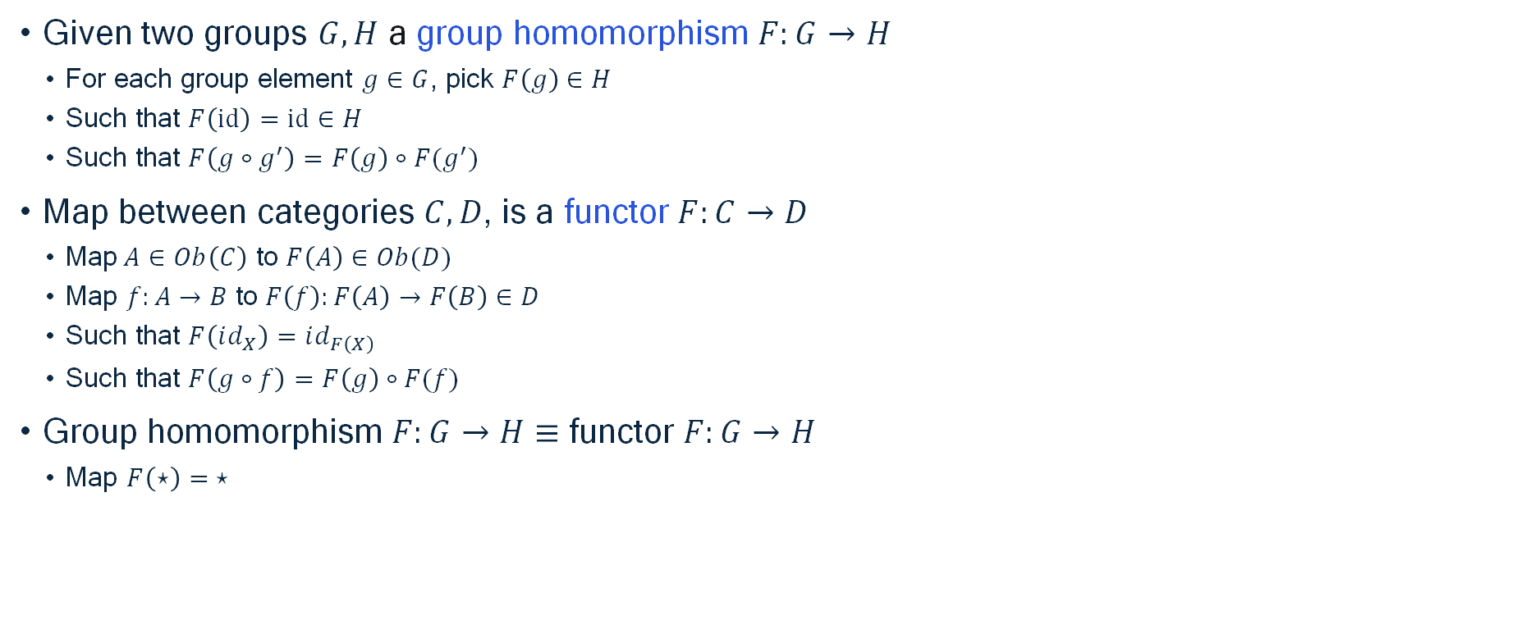
Group homomorphisms
Preservation of compositional structure
Given two groups $G, H$ a group homomorphism $F:G→H$
  For each group element $g∈G$, pick $F\left(g\right)∈H$
  Such that $F\left(id\right)=id∈H$
  Such that $F\left(g∘g^{′}\right)=F\left(g\right)∘F(g^{′})$
Map between categories $C, D$, is a functor $F:C→D$
  Map$A∈Ob\left(C\right)$ to $F\left(A\right)∈Ob(D)$
  Map $f:A→B$ to $F\left(f\right):F\left(A\right)→F\left(B\right)∈D$
  Such that $F\left(id_{X}\right)=id_{F\left(X\right)}$
  Such that $F\left(g∘f\right)=F\left(g\right)∘F(f)$
Group homomorphism $F:G→H$ $≡$ functor $F:G→H$
  Map $F\left(⋆\right)= ⋆$

Slide 14

Examples of functors
Monotone map $F$ between preorders $P, Q$
  Classical: function $F:P→Q$
    Such that $a≤b⇒F\left(a\right)≤F(b)$
  Equivalent to functor $F:P→Q$
  Exercise: prove this
Group action $G$ acting on set $X$
  Classical: $α:G × X→X$
    Such that $α\left(id, x\right)=x$
    Such that $α\left(g,α\left(g^{′},x\right)\right)=α(gg^{′}, x)$
  Equivalent to functor $α:G→Set$
    Maps unique object $α\left(⋆\right)=X$
    Maps group element $α\left(g\right):X→X:x↦α(g, x)$
  Exercise: prove this
Representation $ρ$ of group $G$ on vector space $V$
  Equivalent to functor $ρ:G→Vec$

Slide 15









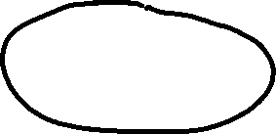




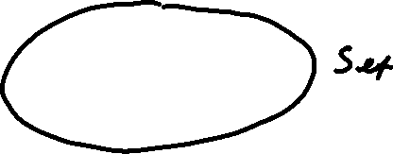

Graphs as functor
Directed multigraph contains
  Set $E$ of edges
  Set $V$ of vertices
  Functions $s,t:E→V$
Category $Par$
Functor $G:Par→Set$
  Maps abstract $ℰ$ to concrete set $G(ℰ)$
  Maps abstract $𝒱$ to concrete set $G(𝒱)$
  Functions $G\left(s\right), G\left(t\right):G\left(ℰ\right)→G(𝒱)$
  No non-trivial compositions

Slide 16
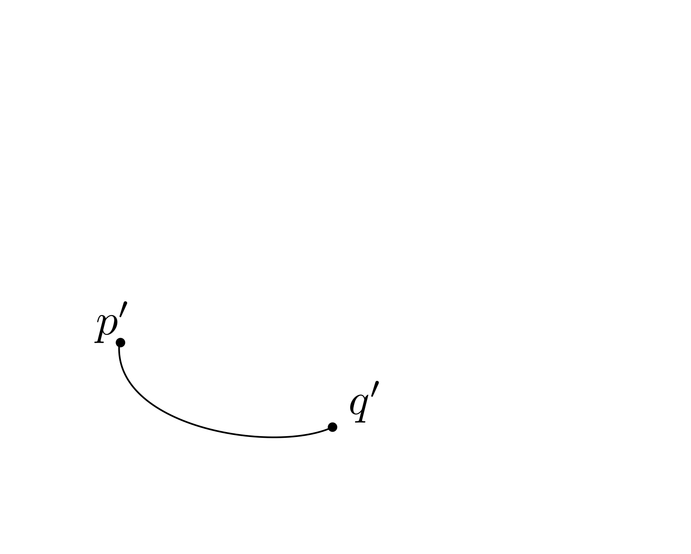

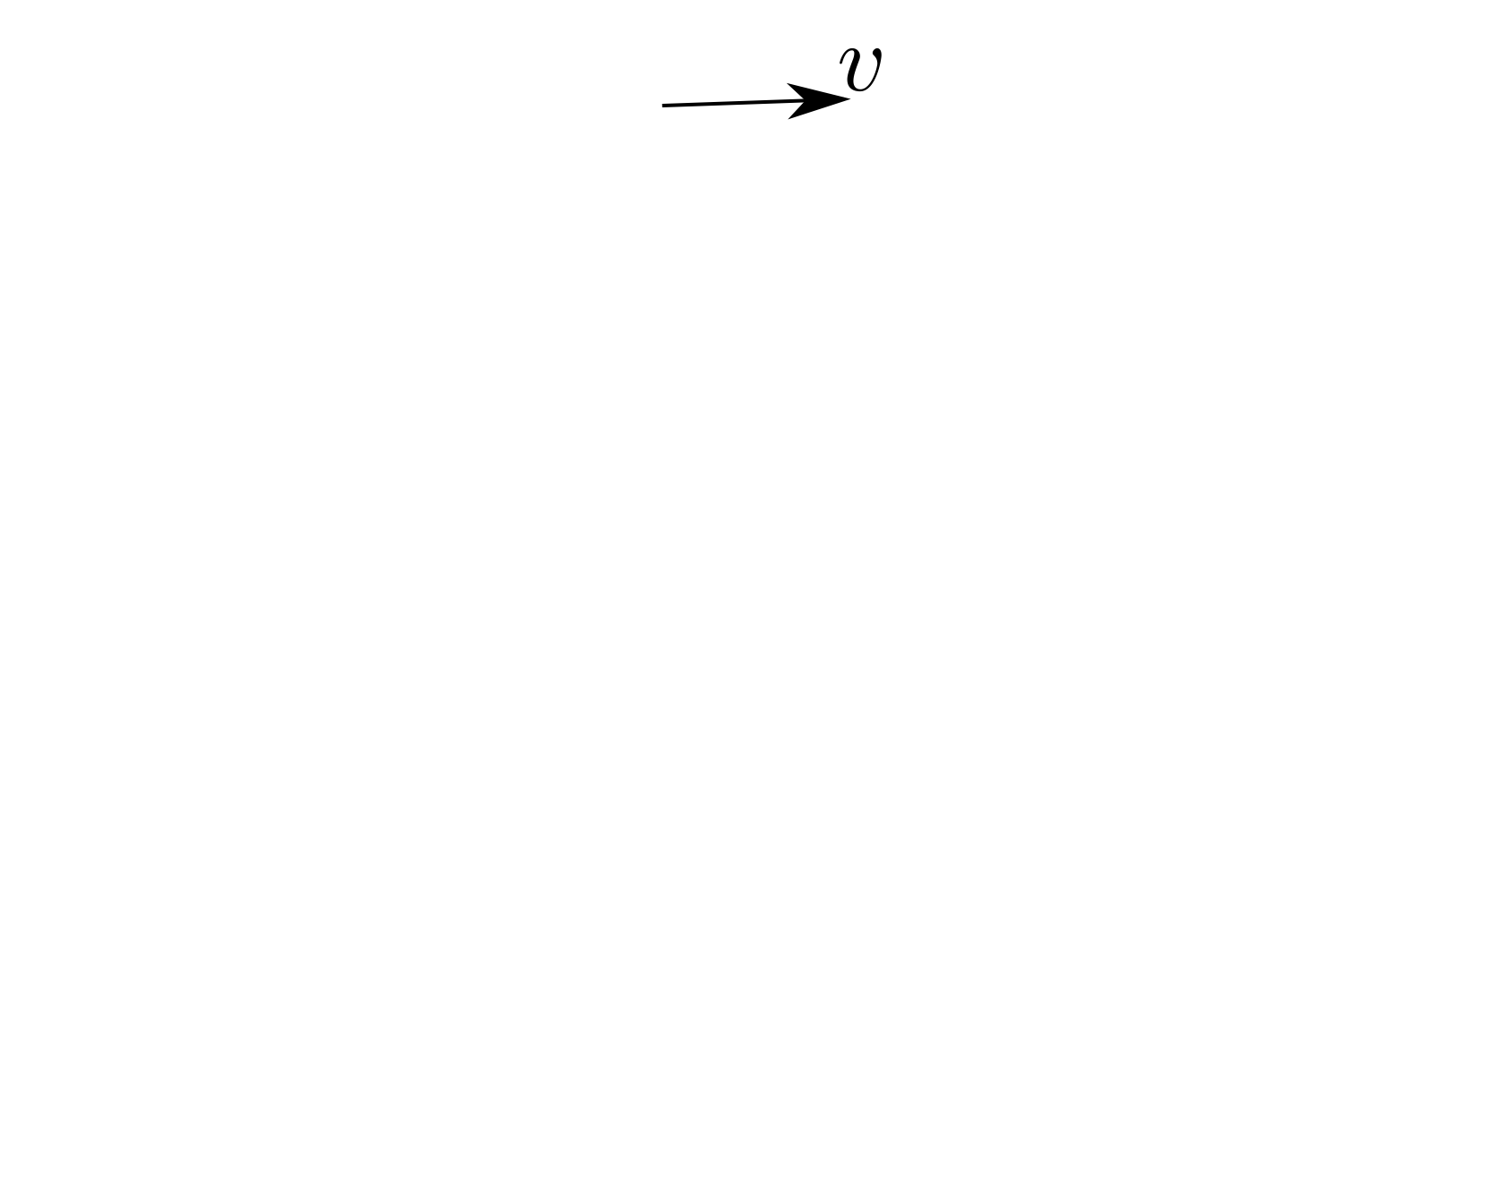
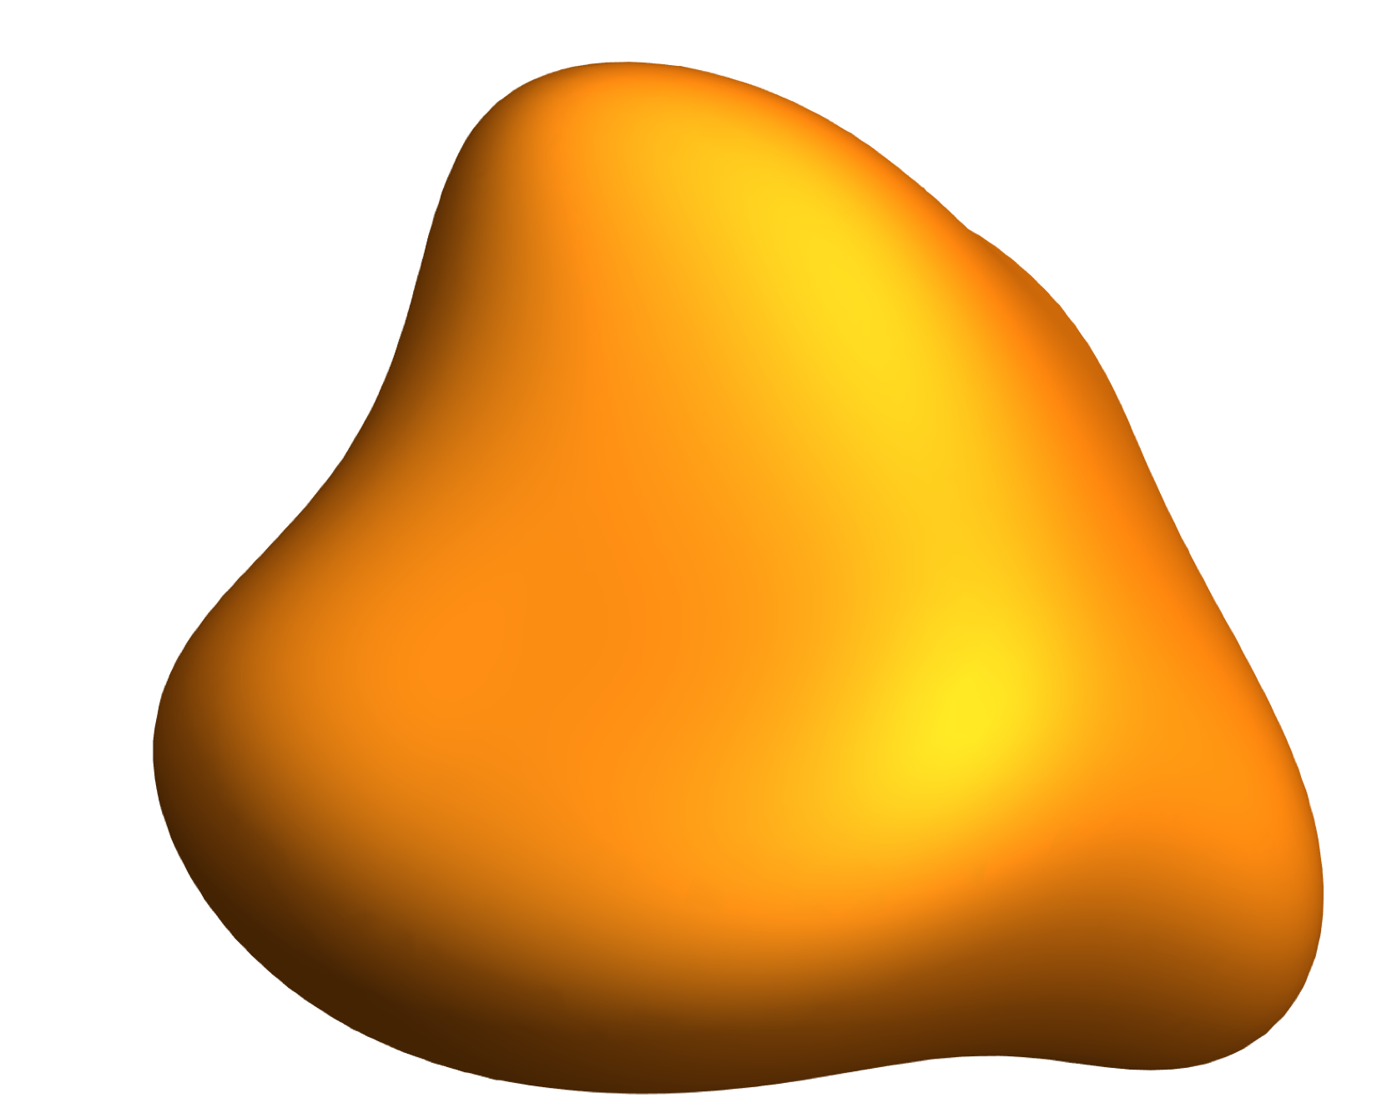
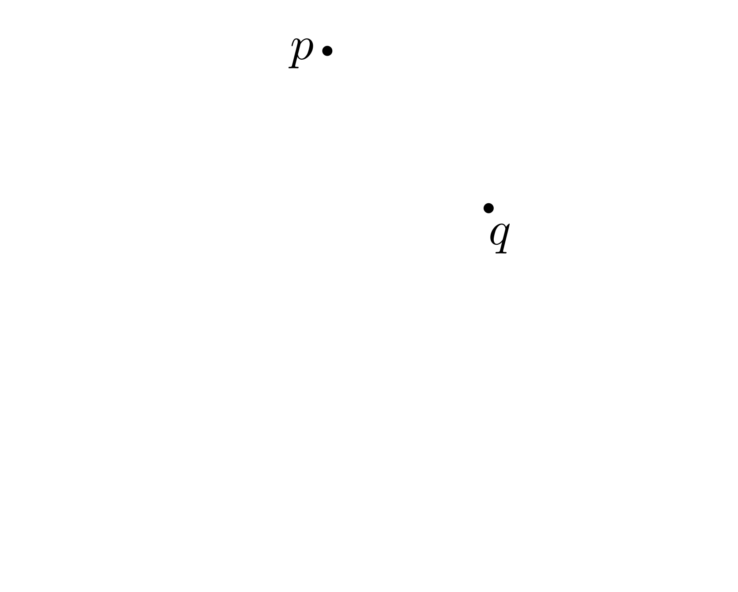






Parallel transport functor
Path groupoid $𝒫\left(ℳ\right)$
  Objects are points $x∈X$
  Morphisms $p:x→y$ are paths from $x$ to $y$
Parallel transport functor $F:𝒫\left(ℳ\right)→Vec$
  Maps point $x$ to tangent space $T_{x}ℳ$
  Maps curve $γ:x→y$ to parallel transport $T_{x}ℳ→T_{y}ℳ$
$$γ$$
$$F(γ)v′$$
$$v′$$
$$γ^{′}$$
$$F(γ^{′})v′$$

Slide 17
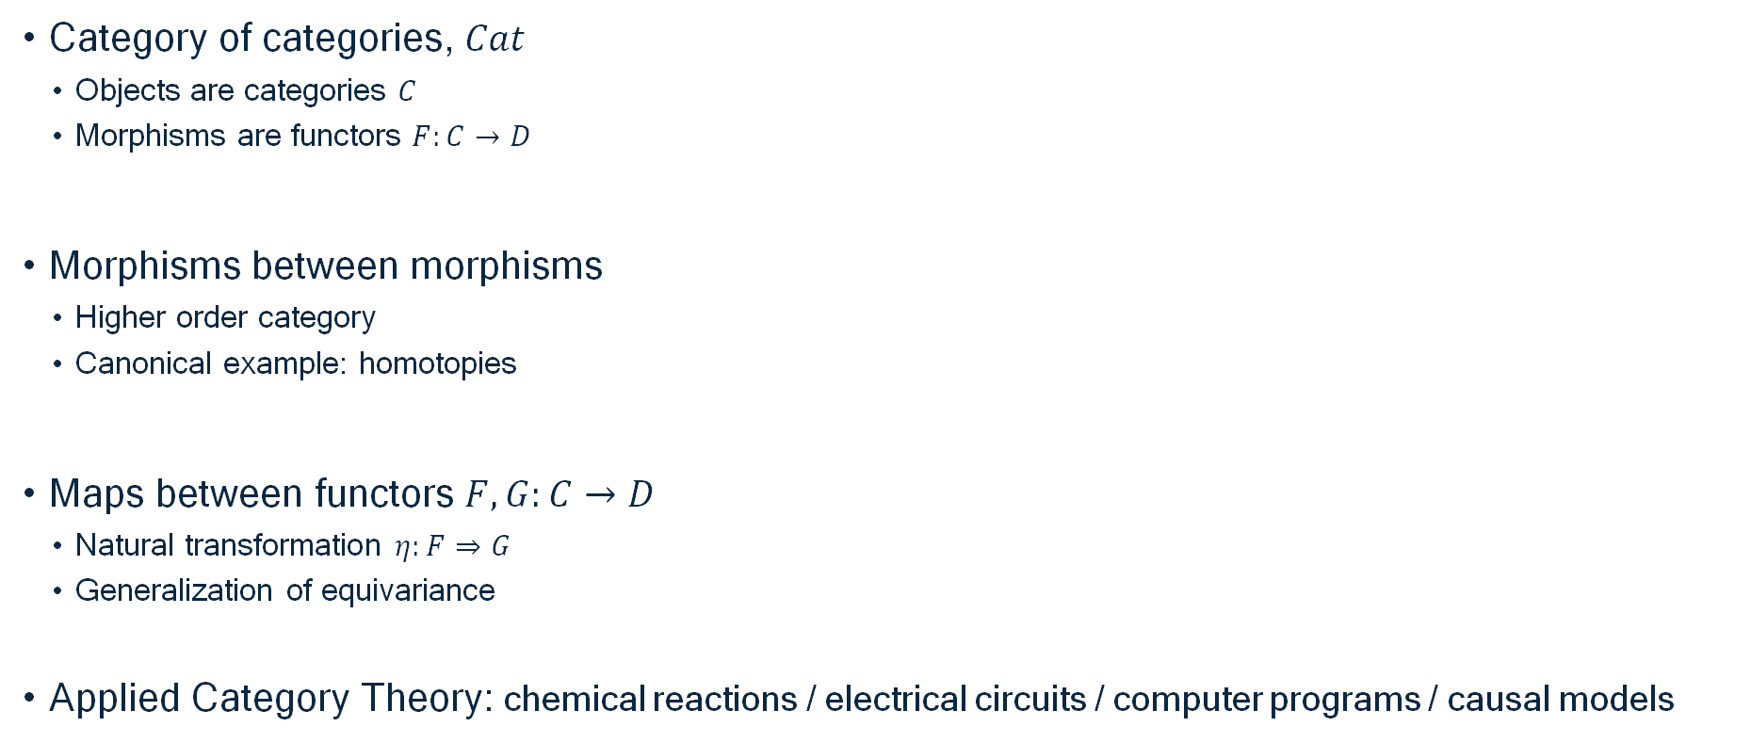




Down the rabit hole
Category of categories, $Cat$
  Objects are categories $C$
  Morphisms are functors $F:C→D$
Morphisms between morphisms
  Higher order category
  Canonical example: homotopies
Maps between functors $F,G:C→D$
  Natural transformation $η:F⇒G$
  Generalization of equivariance
Applied Category Theory: chemical reactions / electrical circuits / computer programs / causal models

Slide 18
Further reading
Perrone, Paolo. "Notes on Category Theory with examples from basic mathematics." arXiv preprint arXiv:1912.10642 (2019).
Riehl, Emily. Category theory in context. Courier Dover Publications, 2017.
Fong, Brendan, and David I. Spivak. "Seven sketches in compositionality: An invitation to applied category theory." arXiv preprint arXiv:1803.05316 (2018).

