Slide 1
Verifying Compliance of Business Process with Temporal Answer Sets
Davide D’Aprile, Laura Giordano,
Valentina Gliozzi, Alberto Martelli,
Gianluca Pozzato, Daniele Theseider Dupré
Università di Torino
Università del Piemonte Orientale
Italy

Slide 2
The ICT4LAW project
“ICT Converging on Law: Next Generation Services for Citizens, Enterprises, Public Administration and Policymakers”
2009-2012, funded by Regione Piemonte
Several partners, including, for procedure compliance with norms:
ITTIG and LOA (CNR)
Augeos, SSB progetti (private companies)
Our universities

Slide 3
Our contribution
Compliance of business/administrative procedures with norms modelled as a problem of reasoning about actions in a temporal action logic.
Business processes modeled by action theories: preconditions and direct effects of events/actions, causal laws implying side effects of events/actions
Norms modeled as formulae in the action theory: preconditions, or causal laws introducing commitments that have to be fulfilled

Slide 4
Our contribution
Procedures and norms translated to a Temporal extension of Answer Set Programming
(a nonmonotonic knowledge representation & reasoning framework)
Verification (that precondition norms hold, that commitments, if introduced, are fulfilled): verifying that temporal formulae hold in all models
Performed as Bounded Model Checking in Temporal ASP

Slide 5
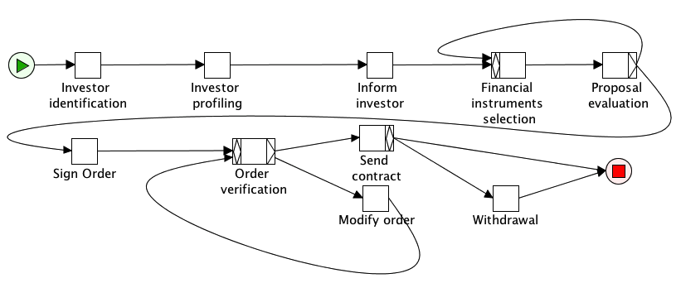
Example
Investment firm offering financial intruments to an investor (simplified version of a case study in ICT4LAW)
Modeled in YAWL [van der Aalst & ter Hofstede]

Slide 6
Norms to be verified
Norm 1: “The firm shall provide the investor adequate information on its policies before any contract is signed”
Norm 2: “If an investor signs a contract, the firm shall provide him a copy of the contract”

Slide 7
Il problema della verifica della compliance alle norme
Stabilire una connessione fra il processo e i concetti ed eventi menzionati nelle norme
Modellare il processo di business
Esprimere formalmente le norme
Effettuare la verifica mediante metodi formali (Model Checking) basati sulla logica temporale

Slide 8
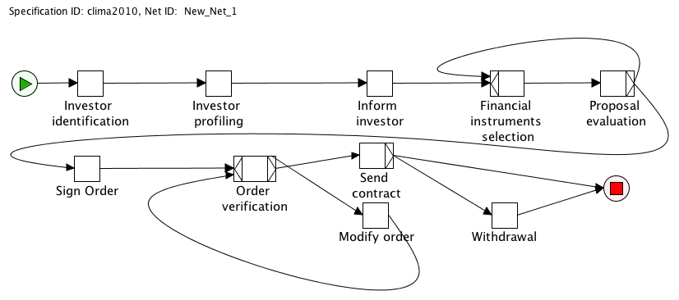
Connessione tramite annotazioni
informato
inviato
firmato
(1) La banca deve fornire all’investitore informazioni adeguate sui suoi servizi e le sue politiche prima che ogni contratto venga siglato
(2) Se l’investitore firma un ordine, la banca è tenuta ad inviargli una copia del contratto

Slide 9
Norme
informato
inviato
firmato
informato
(1) La banca deve fornire all’investitore informazioni adeguate sui suoi servizi e le sue politiche prima che ogni contratto venga siglato
(2) Se l’investitore firma un ordine, la banca è tenuta ad inviargli una copia del contratto

Slide 10
Action theories
Fluents: their truth value describes the state of the world, e.g. informed(I): investor I is informed on the firm policies
Action/event :
performed by an agent or “internal” in the system;
has direct and possibly indirect effects on fluents, causing some state change (unless effect already true)
Action laws: direct effects of actions
Causal laws: fluent dependencies, and then indirect effects of actions
Precondition laws: action can happen only if preconditions hold

Slide 11
Temporal modalities in DLTL
A program is built from actions using “+” (or), “;” (sequence) and “*” (iteration):
a | π₁ + π₂ | π₁ ; π₂ | π *
Temporal formulae include:
[π ] α α holds after all possible executions of π
[a] α α holds after a
and the usual temporal logic modalities:
◊α (eventually), □α (always), ○α (next), αUβ (until)
(their semantics is defined from the one of α U^{π} β
which means: there is an execution of π after which β holds, and α holds in all previous states)

Slide 12
Action laws
General form (l_{i} is a literal – a fluent or its negation):
□ ([a] l₁ or ... or [a] l_{k} ← l’₁ , ... , l’_{m} )
means that:
always, if a is executed in a state where l’₁ , ... , l’_{m} hold, then one of l₁ , ... , l_{k} holds in the resulting state
Example with deterministic effect:
□ ([inform(I)]informed(I) ← investor(I))
Example with nondeterministic effect:
□ ([order_verif(T,I)] confirmed(T,I) or
[order_verif(T,I)] ¬ confirmed(T,I) )
Sounds tautological...

Slide 13
Action laws
... but, unless otherwise stated, fluents persist across events: so, if the order is “not confirmed” before verification, it would persist “not confirmed”
Persistency laws:
□ ([a] l ← l , not [a] ¬ l )
where “not” is default negation

Slide 14
Causal laws
General form (for static causal laws):
□ (l ← l₁ , ... , l_{k} , not l’₁ , ... , not l’_{m} )
model dependencies and indirect effects: if l₁ , ... , l_{k} already hold or are caused to hold, and l’₁ , ... , l’_{m} do not hold or are caused not to hold, then “l” also holds – then if its complement holds, it does not persist
Example:
□ (¬ confirmed(T,I) ← deleted(T,I))
where “confirmed” means “confirmed for the firm” – but the investor can withdraw its order, making “deleted” true as a direct effect, and “confirmed” false as a side effect

Slide 15
Precondition laws
□ ([prop_eval(T,C)] ⊥←
¬ selected(T,C)∨ ¬ informed(C))
the investor cannot evaulate an investment proposal if it has not been selected, or the investor has not been informed on the firm policies
Can either be asserted or verified to be true

Slide 16
Semantic annotationof the business process
It provides the background knowledge, which is common both to the business process and to the norm
Atomic tasks are described as actions through their effects
□[profiling(I)] investor_classified(I)
and preconditions
□([sign_order(I)] ⊥← not informed(I))

Slide 17
Specication of the business process workflow
In [CLIMA 2010] we modelled a business process as a program expression π:
investor identification(I); Profiling(I); Inform(I); fi selection(T,I);
p_eval(T,C);
(accepted(T,I)?; fi_selection(T,I); p_eval(T,I))∗;
accepted(T,I)?;
sign order(T,I); order verif(T,I);
(order confirmed(T,I)?; change order(T,I); order verif(T,I))∗;
order confirmed(T,I)?;
send contract(T,I);
(withdraw(T,I) + skip);
end_procedure

Slide 18
Towards a declarative specification of the BP workflow
Hovewer, this solution is not general enough (unstructured workflows!)
Advantages of a declarative specification over a procedural one (ConDec [Van der Aalst 06], [Montali 2010])
The logical nature of our action language makes it well suited for a declarative specification (DLTL is an extension of LTL)

Slide 19
Example
Profiling can be executed only if the atomic task Investor identification has been executed
[profiling(I)] ⊥← not investor_identified(I)
Profiling has to be executed after Investor identification is executed
□[investor_identification(I)] ◊ <profiling(I)> T
The approach can be generalized for translating YAWL processes into a domain description by action effects, preconditions and constraints.

Slide 20
Norms
Norm 1:“The firm shall provide the investor adequate information on its policies before any contract is signed”
it is a precondition law:
□ ([sign_order(T,C)] ⊥← ¬ informed(C))
to be verified, i.e. it should be true in all models

Slide 21
Norms
Norm 2:“If an investor signes a contract, the firm shall provide him a copy of the contract”
Here, we need the notion of commitment: C(i,j,α)
means that agent i is committed to agent j to make α
true:
□ (C(firm,I,sent_contract(T,I))← order_signed(T,I))
Conditional commitments: CC(i,j, β ,α), agent i is committed to agent j to make α true if β if holds

Slide 22
Norms
Causal laws for commitments:
A commitment for α is discharged if α holds:
□ (○ ¬ C(i,j, α)← C(i,j, α) , ○α)
A conditional commitment becomes a base-level commitment if β holds:
□ (○ C(i,j, α)← CC(i,j, β,α) , ○β)
and the conditional commitment is discharged:
□ (○ ¬ CC(i,j, β,α) ← CC(i,j, β,α), ○β)

Slide 23
Norm verification
For norms which introduce commitments, the formula to be verified is:
□ (C(i,j,α) → ◊α)
i.e. :
The norms formulated as precondition laws;
The formulae □ (C(i,j,α) → ◊α) for all commitments mentioned in other norms
should be true in all interpretations of the domain description
If so, the business process is compliant with the norms

Slide 24
Norm verification
Interpretations are Temporal Answer Sets, an extension of Answer Sets in Answer Set Programming [Gelfond, Leone, Niemelä, ...]
In [Giordano et al, CILC 2010] a translation to standard ASP is given and Bounded Model Checking [Biere et al 2003] is extended to DLTL formulas and used for verification.
The implementation we have developed is based on the DLV system [Leone et al.]

Slide 25
Norms with exceptions
Default negation is used to deal with the non monotonic nature of norms.
It can be used to model priorities in norms:
a norm applies if it is “not blocked”;
a higher priority norm – if it applies (and it is not blocked) – blocks a lower priority norm
Reparation chains in [Governatori] can also be modeled: commitments can be discharged and other commitments generated,
□ (C(i,j,α) → ◊α)
becomes
□ (C(i,j,α) → ◊(α∨¬ C(i,j,α)) )

Slide 26
Summary of contribution
Both procedure and norms modeled in a common logical framework
Nonmonotonicity used to model persistence and complex interaction of norms
Norms of different forms verified using Bounded Model Checking

Slide 27
Related Work
Several proposals in the literature introduce annotations on business processes [Ghose2007,Governatori 2009,Weber 2010].
[Governatori 2009] proposes a logical approach to the problem of business process compliance based on the idea of annotating the business process. Ad hoc algorithms for propagating obligations through the process graph are defined.

Slide 28
Related Work (contd.)
In [Weber 2010] a formal execution semantics for annotated business processes, combining Petri-net like semantics for BPMN process execution with a declarative specification of actions coming from the AI.
[Awad 2008] presents an approach to compliance checking using BPMN-Q, a visual language based on BPMN. BPMN-Q queries are translated into temporal formulas for verification

Slide 29
Related Work(contd.)
In [Montali2010] the Abductive Logic Programming framework SHIFF is used in the declarative specification of business processes. Static and runtime verification of business processes is performed.

Slide 30
Future work
Modeling: derive domain description from (annotated) YAWL models – covering increasingly large subsets of YAWL models
Testing our implementation on benchmark problems to verify the scalability of the approach
Verification: evaluate alternative approaches, e.g.
Model checking based on Petri Net models
Model Checking in Promela / SPIN
and compare with current approach

Slide 31
Thank you!

